Slide 1

Taras Shevchenko National University of Kyiv
Faculty of Sociology
Comparative study of welfare state attitudes:
ESS resources application
Olga Kutsenko olga.kutsenko.ua28@knu.ua

Slide 2
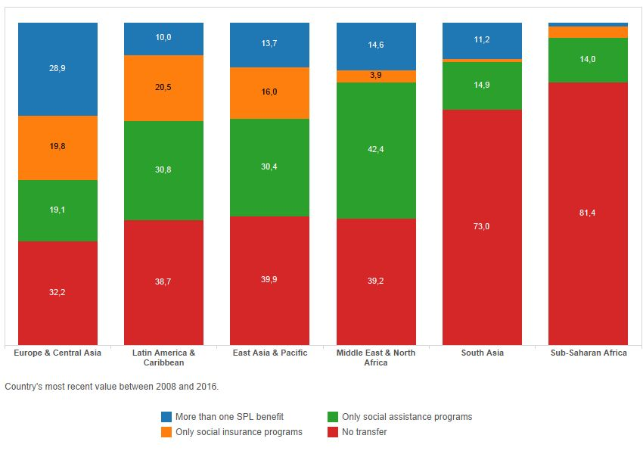
The Coverage of Social Protection in Total Population (global regions %, 2006-2016, The World Bank data)
Notes:
Compared to other regions, aggregate effective social protection coverage (excluding health) in Europe and Central Asia is relatively high, with 84 per cent of the population covered In many countries in the region, particularly in Northern, Southern and Western Europe, comprehensive social protection systems are in place to provide universal (or close-to-universal) protection in at least one area other than health protection. For example, in France, Kazakhstan and Sweden, the entire population is covered by at least one social protection scheme. In other countries social protection coverage is incomplete; this is the case for example in Armenia, Azerbaijan and Georgia, where less than half the population is covered for at least one social protection benefit

Slide 3
Public social protection expenditure, excluding health, in Europe, 2013-2016 (percentage of GDP)*
%
Norway, UK , Slovakia 14
Netherlands, Moldova 13
Estonia, Russian Fed. 11
Latvia, Lithuania,
Romania 10
Albania, Georgia 9
* The International Labor Organization data
%
France, Finland 23
Greece, Belgium 21
Ukraine 20,6
Denmark, Spain, Cyprus 20
Austria 19
Sweden, Hungary, Serbia, Slovenia 17
Germany 16
Poland, Croatia, Belarus 15

Slide 4
Challenges to the Welfare States in Europe
Disastrous effects of population aging, the growing number of pensioners.
The changing world of work: the spread of non-standard and precarious forms of employment, temporary contracts, low pay, ‘platform work’…
The inadequate benefit levels in many countries which trap people in poverty, even those engaged in employment
Effects of damaging traditional social ties and of weakening private forms of solidarity and self-help
The growing migration, inequality
A double bind of rising social benefit expenditures combined with declining government revenues and increased fiscal pressure
Instability…, environmental challenges
The World Social Protection Report, 2017-2010, ILO
https://www.ilo.org/wcmsp5/groups/public/---dgreports/---dcomm/---publ/documents/publication/wcms_604882.pdf)l

Slide 5
The current emphasis in welfare state debates
Shift from the solidaristic welfare state ‘European style’
to the value of individual responsibility and, of private and informal welfare arrangements.
(Taylor-Gooby, 2011).
Again: ‘Who should get what, and why’
+ emphasis on the ‘group membership’ dimension
(who belongs to the ‘imagined community’ of fellow citizens one feels responsible for).

Slide 6
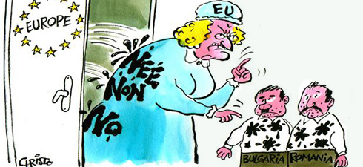
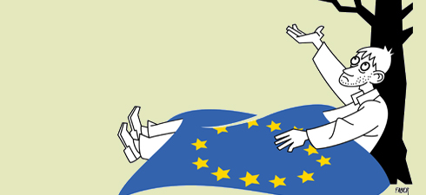
What kind of state intervention into individual and social welfare do people in various European countries ask for?
What attitudes do citizens in various European countries towards welfare solidarity?
How satisfied are they with what the welfare state achieves?

Slide 7
European Social Survey
1. The ESS Round 4 module (fielded in 2008\-2009) “Welfare Attitudes in a Changing Europe”
Principal applicant: Stefan Svallfors (Stockholm, Sweden)
Data - 29 European countries including Ukraine
www.europeansocialsurvey.org
2. The ESS Round 8 module (fielded in 2016/17) “Welfare Attitudes in a Changing Europe: Solidarities under Pressure”
- provided a shift towards issues of the fairness, direction and degree of solidaristic redistributions and welfare reforms
Principal applicant: Win van Oorschot (University of Leuven, Belgium)
Data - 23 European countries without Ukraine
https://www.europeansocialsurvey.org/docs/round8/questionnaire/ESS8_van_oorschot_proposal.pdf

Slide 8
A conceptual framework for analyzing welfare state attitudes (Svallfors-2005, Oorschot -2012)
‘Welfare state attitudes’
Welfare state scope and responsibilities
Target groups / receivers
Activation policies (R8)
‘Welfare future’ preferences (R8)
Predispositions
Trust
Personal experiences
Risk perception
Inequality beliefs
Gender traditionalism
Perceived social problems
Evaluations
Task performance (personal + general)
Perceived consequences (economic, moral, social)
Risks & resources: - Demographic factors
• Insecurity, precariousness, resources

Slide 9
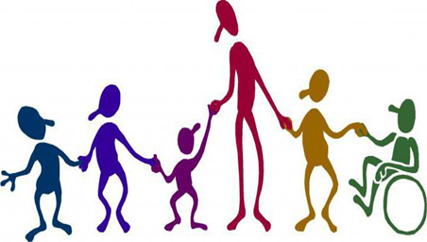
Empirical research questions:
What types of the welfare state attitudes do encompass European nations?
Where is Ukraine located on the welfare attitudes typological map?
Database: ESS-4 (2008\09)

Slide 10
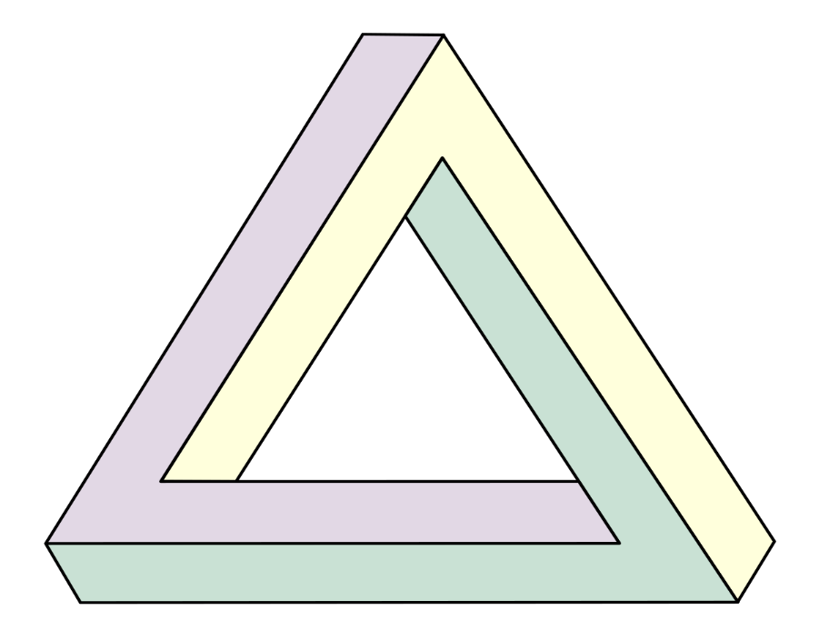
Three empirical dimensions of the welfare attitudes (ESS-4, 2008\09)
Expectations of welfare state scope and responsibilities (StatResp)
Risk assessment of a welfare state (RiskSS)
Perceived consequences of a welfare state (BenfSS)

Slide 11
Risk assessment for the individual well-being in selected European countries
(‘no risks’ 0 < I < 3 ‘very high risks’)
Indicators:
Probability to loss of work
reducing of working hours and income
poverty
inaccessibility of medical care

Slide 12
Perceived consequences of a welfare state: two-factor solution for all countries
(pooled data, principal component analysis, varimax rotation)
To what extent do you agree or disagree that social benefits and services in your country… | Factors
 | 1 | 2
D29 …make people less willing to look after themselves and their family? | 0.849 | 0.054
D27… make people lazy? | 0.843 | 0.052
D28 …make people less willing to care for one another? | 0.843 | 0.073
D21 …place too great a strain on the economy? | 0.661 | 0.103
D25 …cost businesses too much in taxes and charges? | 0.630 | 0.127
D23 …lead to a more equal society? | 0.041 | 0.821
D22 …prevent widespread poverty? | 0.106 | 0.797
D26 …make it easier for people to combine work and family life? | 0.117 | 0.765
Percent of variance | 38% | 24%

Slide 13
Four empirical models of expectations and assessments towards the welfare state
"Skepticism" - risk assessment of the welfare state and the accent on negative consequences for a society and the individuals.
"Approval" – positive assessment of the welfare state, and its social and individual consequences.
"Egalitarianism" – the accent on social equity in wealth distribution in a society.
“Etatism" – significant assessment of a state itself and its role in the well-being protection in a society

Slide 14
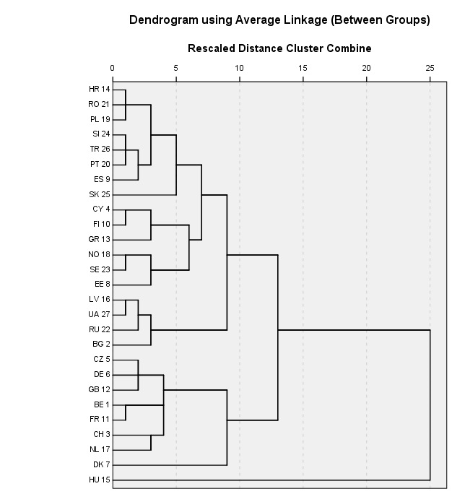

Hierarchical clusterisation of 28 countries in 3-dimensional empirical space (Ward's method)
1 – liberal (CZ, DE, GB)
2 – continental (FR, BE, CH, NL)
3 – soc.-democrat, Nordic (SE, NO, EE)
4 – South Europe (ES, PT, TR, SL)
5 – Greek-Cypriot (GR, CY)
6 – post-Socialist, critical (PL, RO, HR)
7 – post-Socialist (UA, RU, LV, BG)
1
6
4
5
3
2
7
1
2
1

Slide 15
Clusters of European countries in 3-dimensions concerning welfare state expectations and assessments, 7 national clusters
Nationally-based clusters of the welfare state attitudes |  |  | 1 - Etatism | 2 – Egalitaria-nism | 3 – Skepticism | 4 – Approval | Models of expectations and assessments of welfare regims
1 | 4 ES, PT, TR, SL | Mean | 8,02 | 5,49 | 5,08 | 5,18 | Southern Europe (post-authoritarian, etatistic)
 |  |  | higher | Very high | higher | higher
 | 5 GR, CY | Mean | 8,62 | 5,64 | 5,49 | 4,27 | Greek-Cypriot (etatistic egalitarian)
 |  |  | Highest (max) | Highest (max) | Very high | lower
 | 7 UA, RU, LV, BG | Mean | 8,41 | 5,26 | 4,05 | 3,90 | post-Socialist (etatistic and egalitarian)
 |  |  | Very high | higher | lower | lower
 | 3 SE, NO, EE | Mean | 7,76 | 4,34 | 5,60 | 4,78 | Social-democratic, Nordic (communitarian)
 |  |  | moderate | lower | Very high | lower
 | 2 FR, BE, CH, NL | Mean | 6,98 | 4,86 | 5,50 | 5,52 | Continental (solidaristic and critical))
 |  |  | Very low | Lower | Very high | Very high
 | 1 CZ, DE, GB | Mean | 7.22 | 4.36 | 5.08 | 5,49 | Liberal (critical)
 |  |  | lower | lower | Higher | Very high
 | 6 PL, RO, HR | Mean | 7,65 | 4,88 | 4,61 | 5,26 | post-Socialist, critical but policy-oriented
 |  |  | Lower | lower | lower | Higher
 | General Mean |  | 7,77 | 4,98 | 4,87 | 4,97

Slide 16
The structural-based model of the welfare state attitudes, cases of 6 countries
 | GB | DE | SE | PL | RU | UA
Skepticism | -0.108* | -0.142* | -0.103* | -0.107* | -0.167* | -0.164*
Approval | 0.079 | 0.052* | 0.140* | 0.099* | 0.062* | 0.000
Etatism | -0.114* | -0.094* | -0.028 | -0.172* | -0.213* | -0.197*
Equality | 0.269* | 0.271* | 0.287* | 0.274* | 0.256* | 0.140*
Trust | 0.056* | 0.015 | 0.030 | -0.037 | 0.111* | -0.121*
Reciprocity | -0.059* | -0.106* | -0.037 | 0.000 | 0.006 | 0.034
Type of employment | 0.060* | 0.023 | 0.006 | 0.023 | 0.006 | 0.038
Gender | -0.018 | -0.038 | -0.108* | -0.080* | 0.039 | -0.052
Ag_25 and less | 0.050* | 0.000 | -0.059* | 0.112* | -0.001 | 0.004
Education | -0.078* | -0.076* | -0.035 | -0.176* | -0.067* | 0.072
Urban | 0.010 | -0.018 | -0.041 | 0.007 | -0.095* | -0.082*
Low income | 0.041 | 0.035 | -0.003 | -0.065* | 0.069* | 0.108*
R² | 0.16 | 0.19 | 0.18 | 0.25 | 0.22 | 0.16

Slide 17
The main empirical findings (2008\09)
Two macro-clusters of the welfare state attitudes in Europe: I – the continental and nordic ; II – the southern and eastern;
Strong specificity of the post-Soviet welfare attitudes: the people are strongly in favor of welfare provision by the state, but they are disappointed about what their states actually deliver;
Skepticism is highly manifested in the welfare state attitudes in all European countries, besides the post-Socialist (especially – post-Soviet) Europe.
4. The welfare state attitudes do not closely follow Esping-Andersen’s three worlds of welfare capitalism. There are 7 different national clusters of the welfare state attitudes in Europe.
5. The values of equity and a state per se are the most predictors of the welfare state attitudes. There are sizeable differences in class effects on welfare attitudes between European countries, for which no successful explanations are found as yet.

Slide 18

Thank you for attention !

Slide 19
Empirical indicators of three dimensions of mass expectations
1. Expectation of social responsibility of a state
Additive index is calculated as the mean of variables D15-D20, highly correlates with the one-factor solution ( for every country). The one-factor solution explains from 47 % (for the Great Britain) to 57 %.
The reliability coefficient Cronbach’s , which characterizes the internal consistency of the additive index, is a rather high in each country and varies from 0.76 (for Great Britain) up to 0.84 (for Ukraine)
The question and its alternatives:
“People have different views on what the responsibilities of governments should or should not be. How much responsibility governments should have to…?”
D15 - …ensure a job for everyone who wants one?
D16 - …ensure adequate health care for the sick?
D17 - …ensure a reasonable standard of living for the old?
D18 - …ensure a reasonable standard of living for the unemployed?
D19 - …ensure sufficient child care services for working parents?
D20 - …provide paid leave from work for people who temporarily have to care for sick family members?

Slide 20
2. Assessment of social risks of a welfare state (RiskSS)
The two-factor solutions (principal component analysis) for the data of each country have very similar structures and interpretations and explain quite similar amount of variance.
For unification of the measurement’s tool and for further cross-national comparison, the final factor analysis was done on pooled six countries data. Two-factor solution has the same clear interpretation and explains 62% of general variation.
The estimated factors values were linearly transformed that allowed us to form next the index and index of estimation of social risks from a welfare state (RiskSS).
The question and its alternatives:
“To what extent do you agree or disagree that social benefits and services in your country…”
D29 …make people less willing to look after themselves and their family?
D28 …make people less willing to care for one another?
D27… make people lazy?
D26 …make it easier for people to combine work and family life?
D25 …cost businesses too much in taxes and charges?
D23 …lead to a more equal society?
D22 …prevent widespread poverty?
D21 …place too great a strain on the economy?

Slide 21
Percentage of unemployed persons in Europe receiving unemployment cash benefits,
2015 or latest available year, ILO data
%
Germany, Austria, Finland 100
France 95
Netherland 75
Russian Fed 68
Denmark 67
Norway, Switzerl., UK 60-62
Spain, Belarus 45
Portugal, Estonia 42
%
Czech Rep 36
Latvia 33
Slovenia, Sweden 26
Ukraine, Lithuania 22
Greece, Croatia 20-21
Hungary, Poland 16-17
Moldova 11
Azerbaijan, Kirgizstan < 2
Armenia 0
https://www.ilo.org/wcmsp5/groups/public/---dgreports/---dcomm/---publ/documents/publication/wcms_604882.pdf

Slide 22
Public Spending on all Social Assistance Programs* in Post-Socialist Europe (% of GDP, 2013-2016, The WB data)
Ukraine 4,4 2014
Croatia 3,4 2014
Hungary 3,1 2013
Belarus 3,1 2015
Slovak R. 2,4 2013
Poland 2,0 2013
Russian F. 1,9 2015
Bulgaria 1,4 2014
Moldova 1,3 2016
Romania 1,1 2014
Latvia 0,8 2012
Lithuania 0,5 2016
* cash transfers, in-kind, social pensions, school feeding, social works, fee waivers, other
http://datatopics.worldbank.org/aspire/country/

Slide 23
In 2015 or latest available year (ILO data):
Percentage of persons with severe disabilities in Europe receiving disability cash benefits, - 100%,
except for:
Austria, Israel, Portugal 90-93%
Spain 84 %
Kirgizstan, Germany 76%
Malta 60 % ; Cyprus 27%
Percentage of population above statutory pensionable age in Europe receiving an old-age pension – 100%,
except for:
Israel, Ireland 96-98
Tajikistan, Georgia, Ukraine 92-93
Russian Fed. 91
Greece, Albania 77
Moldova 75 ; Croatia 58
Serbia 46; Bosnia&Herz. 30

