Slide 1

THE ESS: BACKGROUND AND LATEST FINDINGS
Ukrainian participation in the ESS: academic and policy benefits and challenges
20 September 2018
Taras Shevchenko National University of Kyiv
Eric Harrison
Deputy Director, ESS ERIC
Notes:
This presentation will highlight…

Slide 2
Outline of my talk
What the ESS is
How you can use it
Who else uses it and what they do with it
The ESS Ukraine years: some stories in pictures
What you (and we) have missed while you’ve been away
Round 9: Still time to be part of it!
Ukraine and ESS ERIC by 2020 - Member, Guest or Just Good Friends?

Slide 3
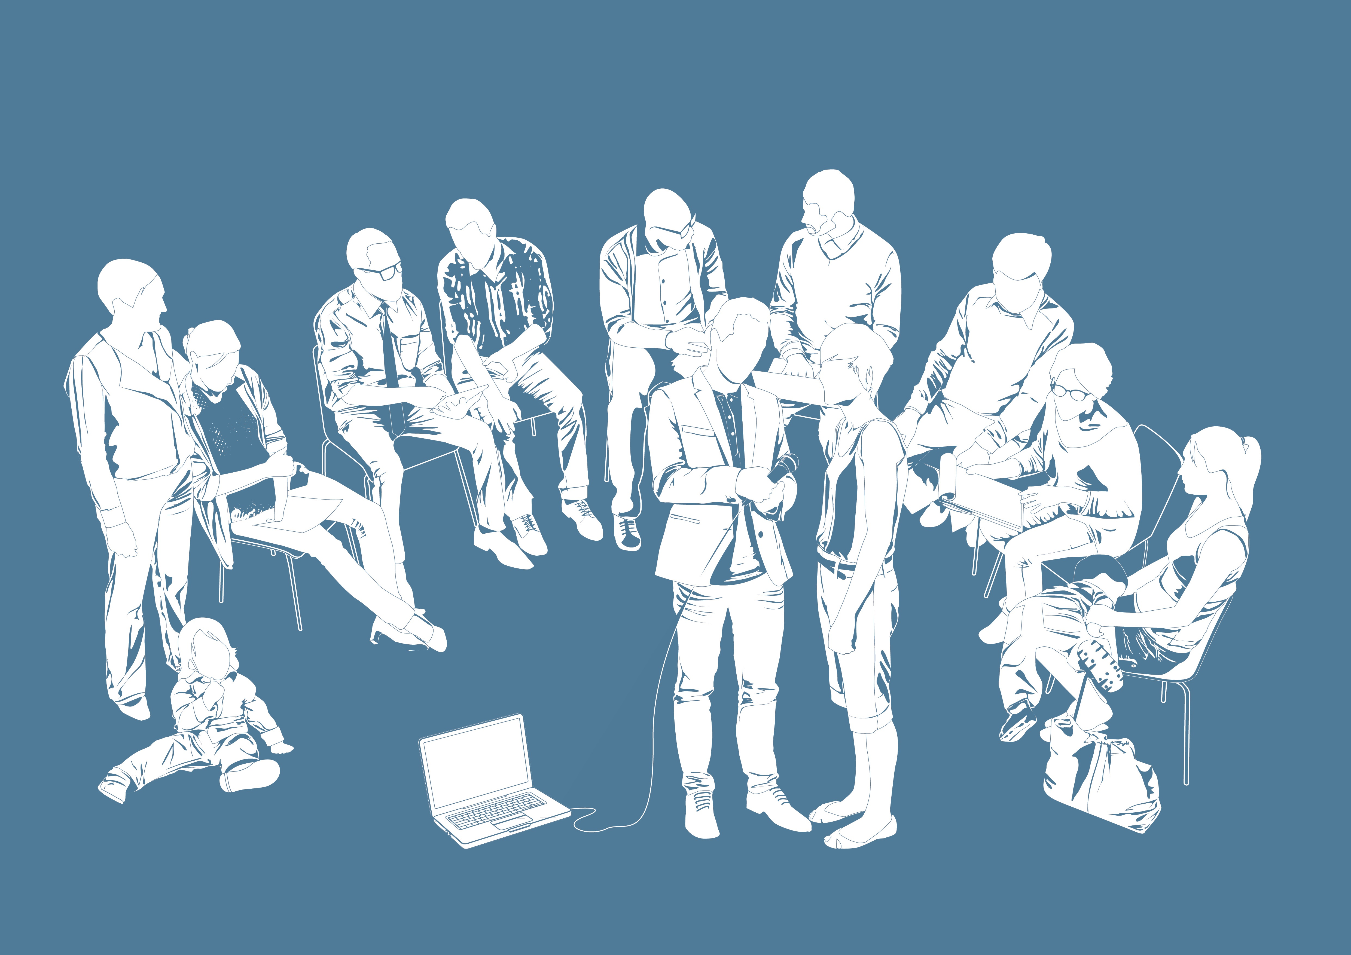
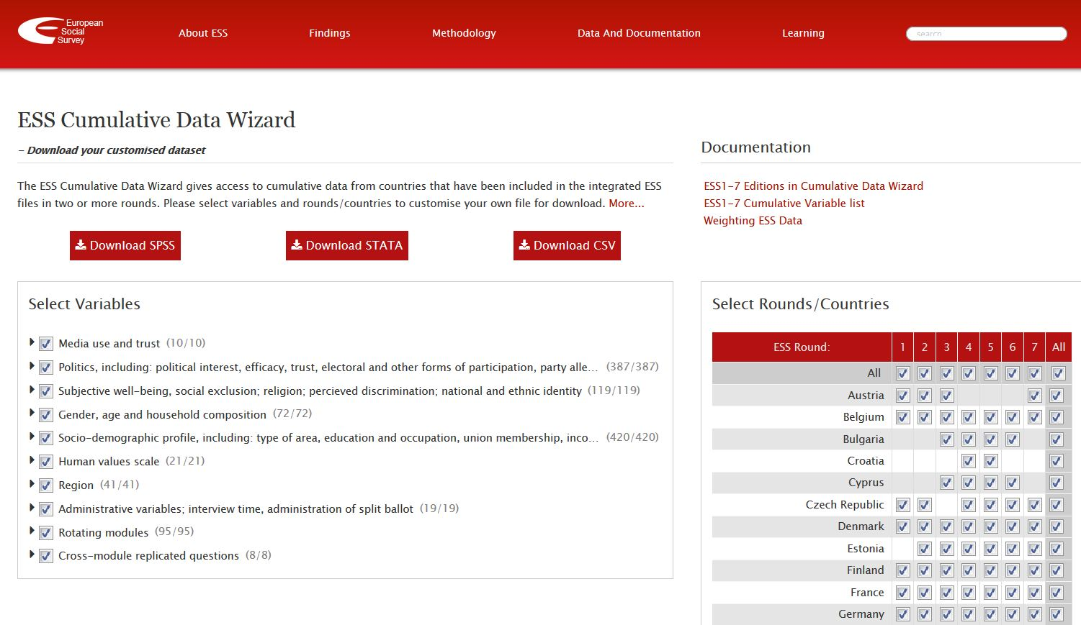
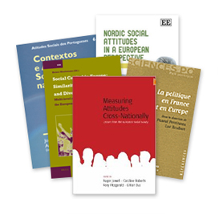
ESS Background
Academic cross-national survey measuring attitudes
Face-to-face interviews every two years (since 2002)
Over 380,000 interviews completed
Data collection by a range of providers
8 rounds completed in 36 countries
Fieldwork for Round 9 began last week
All data free for non commercial use
Over 125,000 registered users
3,554 academic publications used data (2004-16)
Notes:
Face to face interviews take about one hour to complete
Over 8 rounds, there were 381,351 face to face interviews, with over 44,387 in Round 8
Data collected by a survey agency in each country or by Government agencies that have capacity to undertake the interviews
Publications information courtesy of Google Scholar (Brina Malnar)

Slide 4
ESS Aims
Chart stability and change to interpret how Europe’s social, political and moral fabric is changing
Achieve and spread higher standards of rigour in cross-national research
Introduce soundly-based indicators of national progress
Undertake and facilitate the training of European social researchers
Improve the visibility and outreach of data on social change

Slide 5
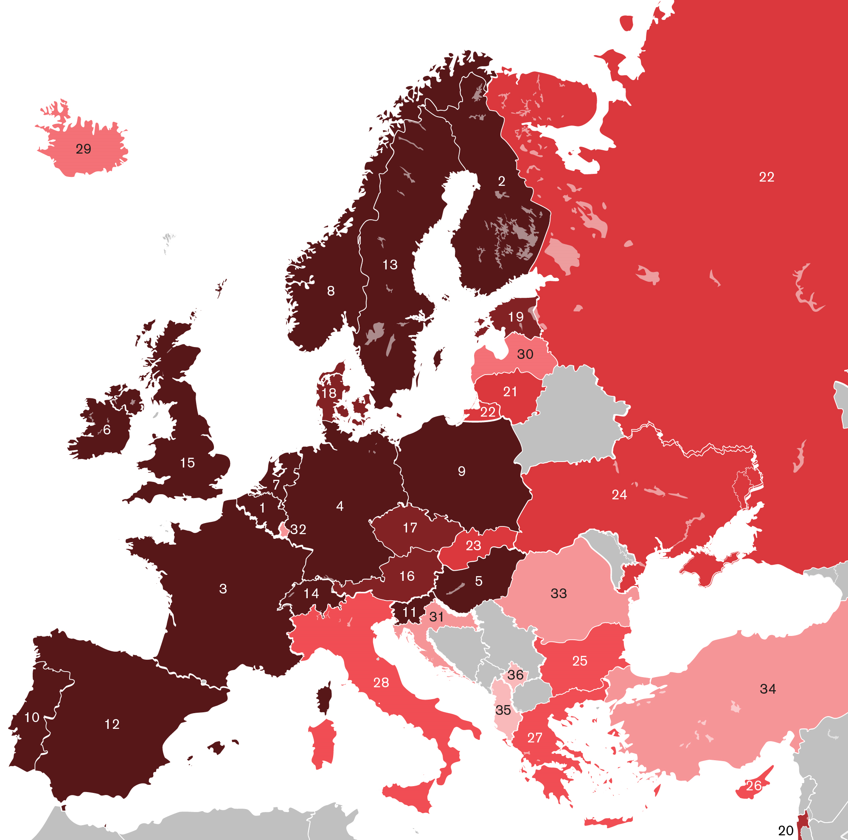
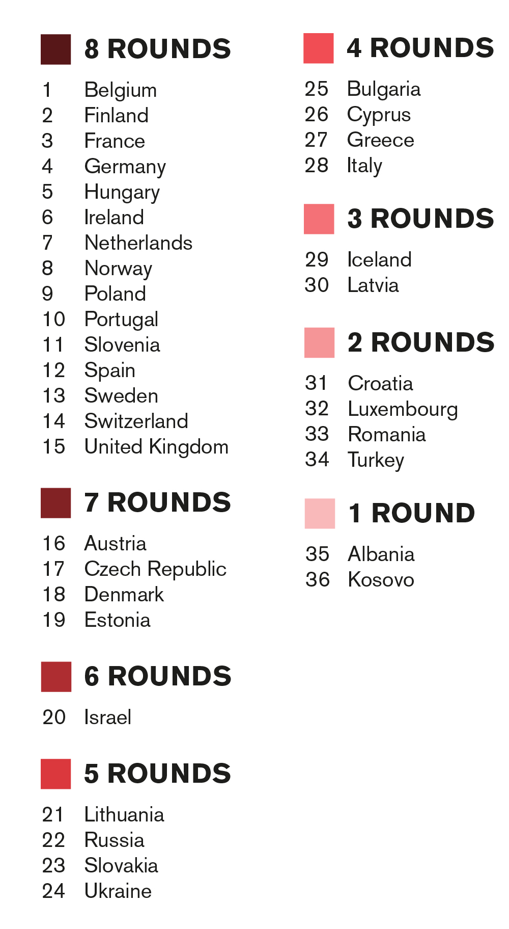
Participating Countries
Notes:
36 countries have taken part in at least one round since 2002.
15 of these (in yellow) have taken part in all 8 rounds.
Concentration of countries in Western Europe.
Attempting to bring countries in the East.
Those who haven’t been a part of ESS before, like: Belarus, Moldova, Serbia, Macedonia, Bosnia.
Encouraging countries to be involved again: Bulgaria, Kosovo, Greece, Croatia, Romania, Albania.

Slide 6
ESS Questionnaire
CORE TOPICS IN
ALL ROUNDS
Crime
Democracy and politics
Human values
Immigration
Media use
National and ethnic identity
Perceived discrimination
Religion
Social exclusion
Social trust/trust in institutions
Subjective wellbeing
Socio-demographics
Notes:
Round 10 (2020/21) rotating modules have also now been selected:
Europeans’ understandings and evaluations of democracy will repeat a number of questions that were included in Round 6 of the ESS, fielded in 2012/13. This latest proposal on democracy includes 20 items that were asked in 2012/13 and another 11 questions that will be asked for the first time.
Digital social contacts in work and family life is a brand new module. The module will primarily assess the attitudes and behaviour of respondents on internet and smartphone access and associated privacy concerns, intergenerational contact, remote working and proficiency in using the internet and mobile phones.

Slide 7
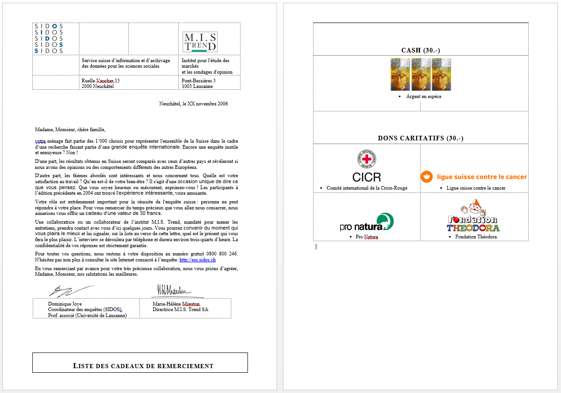
ESSentials: Advance Letter

Slide 8
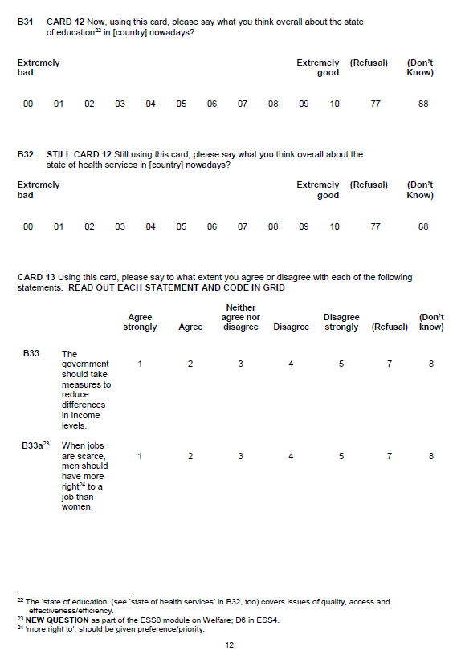
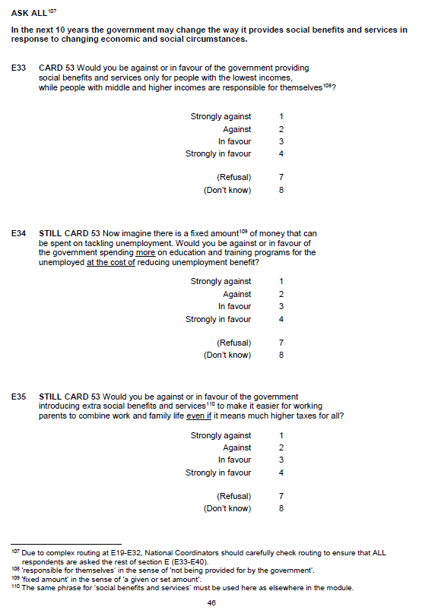
ESSentials: Questionnaire

Slide 9
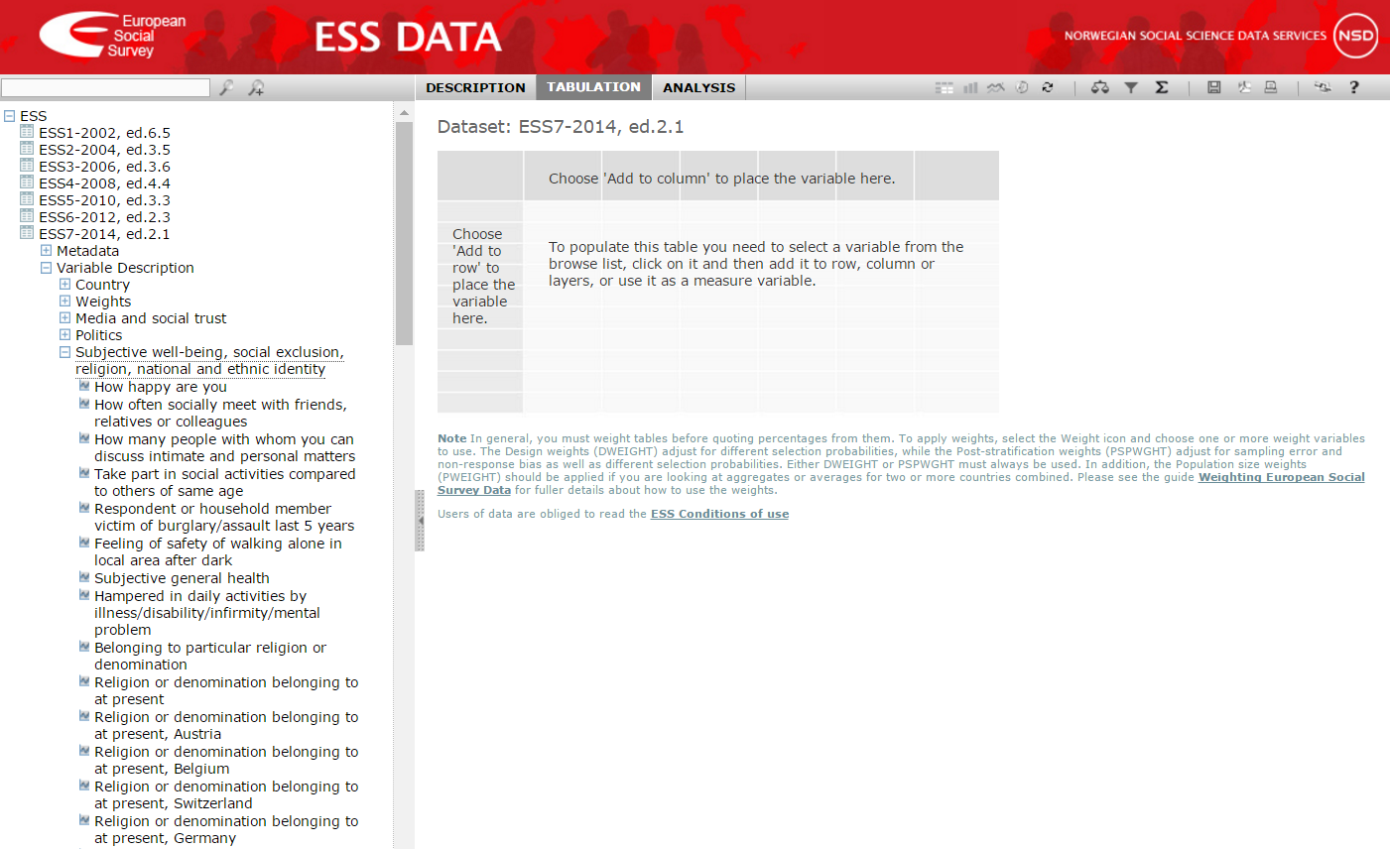
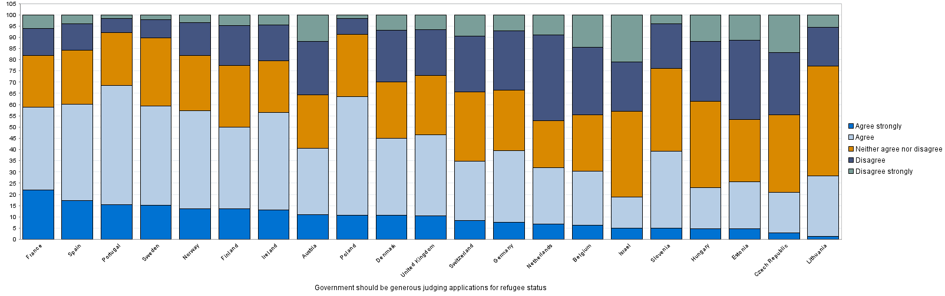
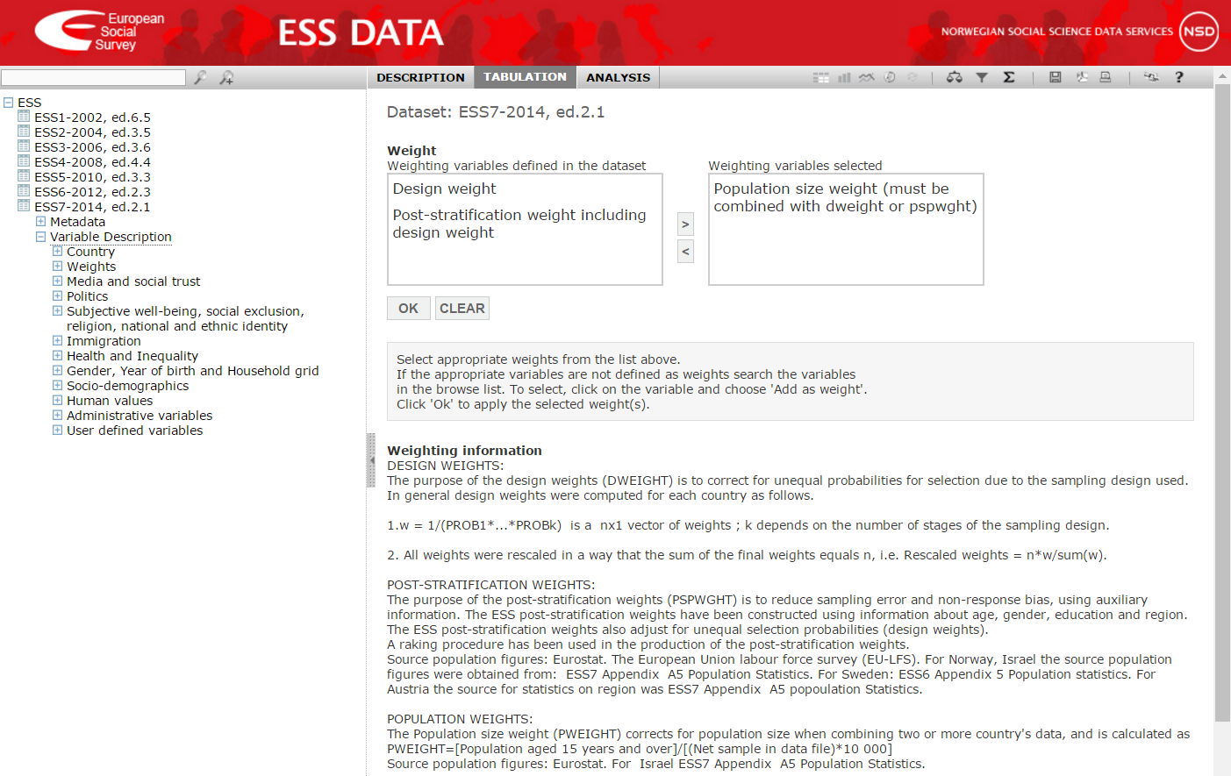
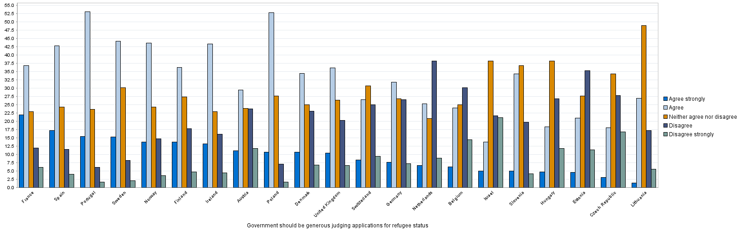
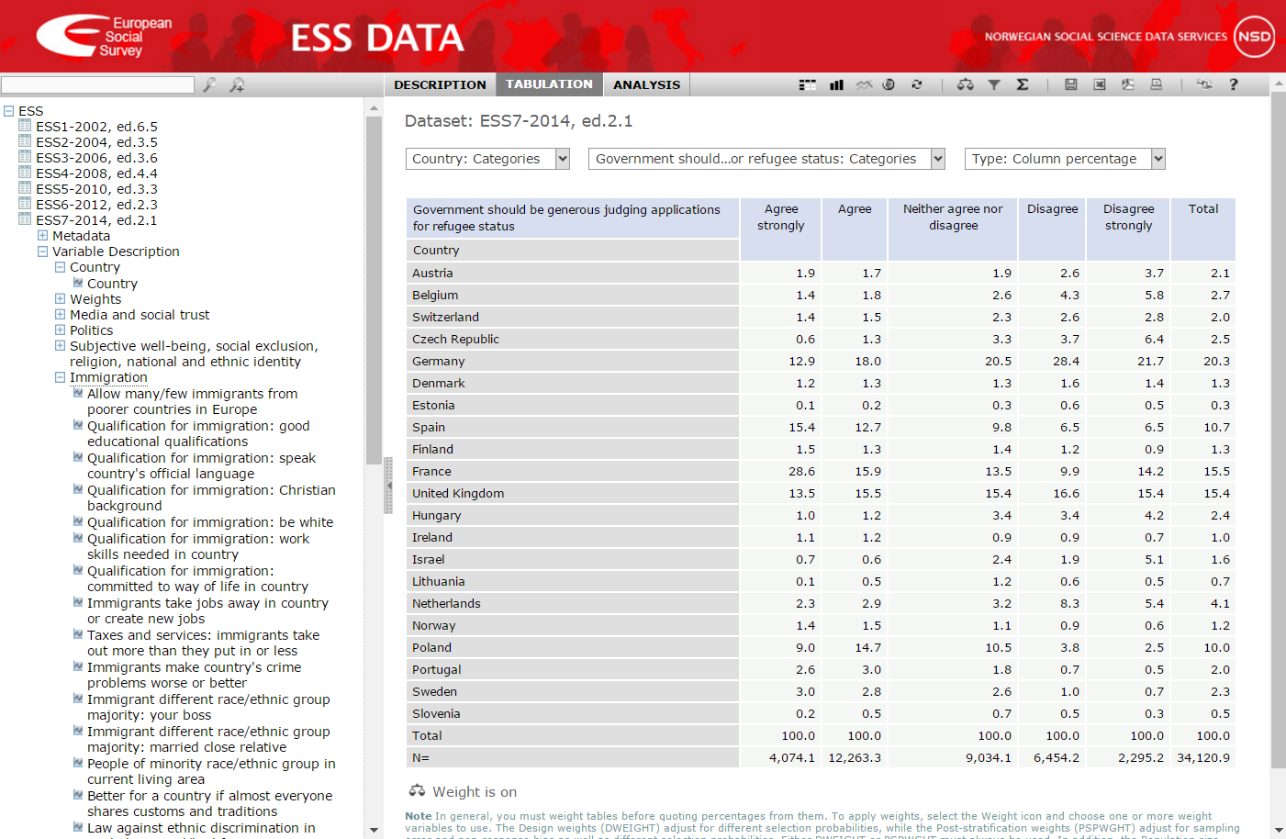
ESSentials: Online Analysis
Data
+
Weights
=
Results
Notes:
Data
All ESS data is available from Round 1, 2002 to Round 8, 2016)
Data sets listed by question or country in the left hand column
All question descriptions are listed under the Description tab
When you want to select data, select the Tabulation tab
Left click on the question, and then choose either Add to column or Add to row
Place countries in a row, and the question in a column
Weights
Before carrying out any data analysis you need to weight the data
The design weight should always be applied
The population size weight should also be applied when ‘pooling’ or ‘aggregating’ data for groups of two or more countries or calculating averages for the whole ESS dataset
The post-stratification weight should be applied…
The message ‘weight is on’ will appear in red underneath the empty table
Results
The data will then appear in the table

Slide 10
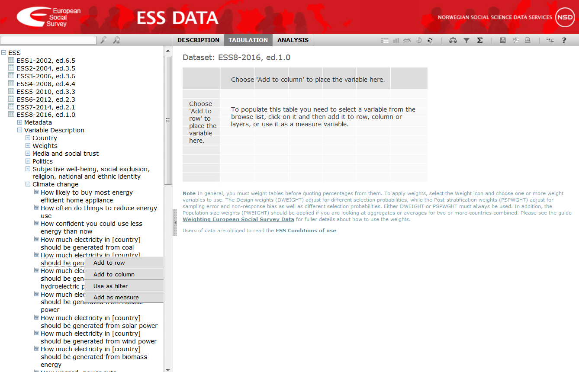
Online Analysis
Notes:
My background isn’t exactly data analysis so I find the easiest way is to analyse survey items online using our Online Analysis tool
The tool has online training attached but I will give you a quick overview now
Register as a data user
Click on ‘ESS online analysis’
To view data online…

Slide 11
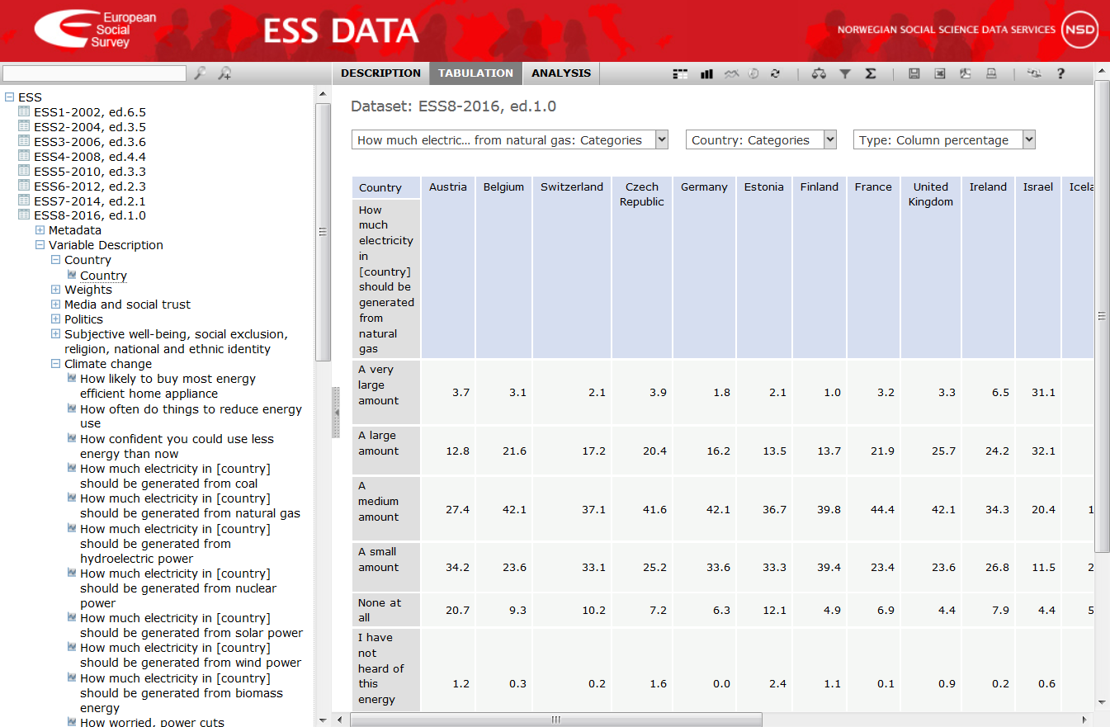
Online Analysis
Notes:
My background isn’t exactly data analysis so I find the easiest way is to analyse survey items online using our Online Analysis tool
The tool has online training attached but I will give you a quick overview now
Register as a data user
Click on ‘ESS online analysis’
To view data online…

Slide 12
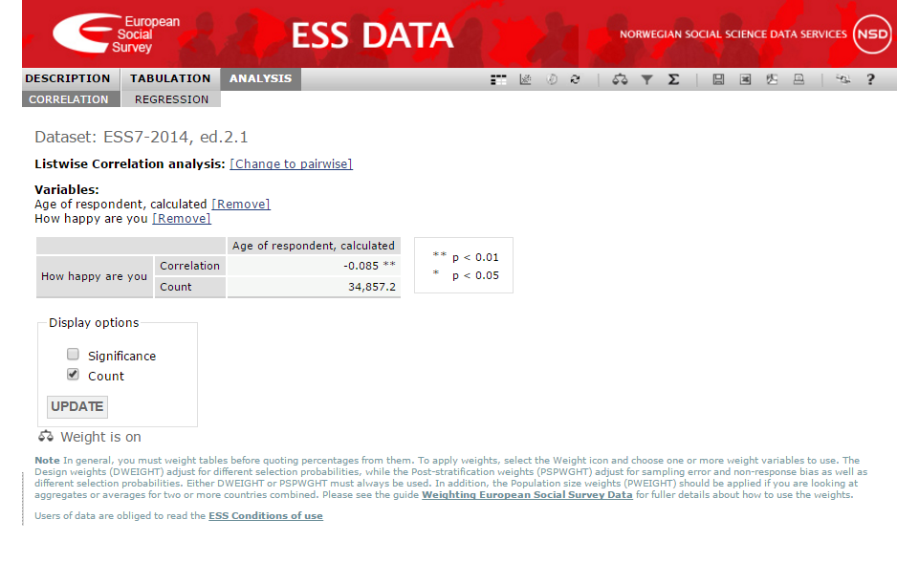
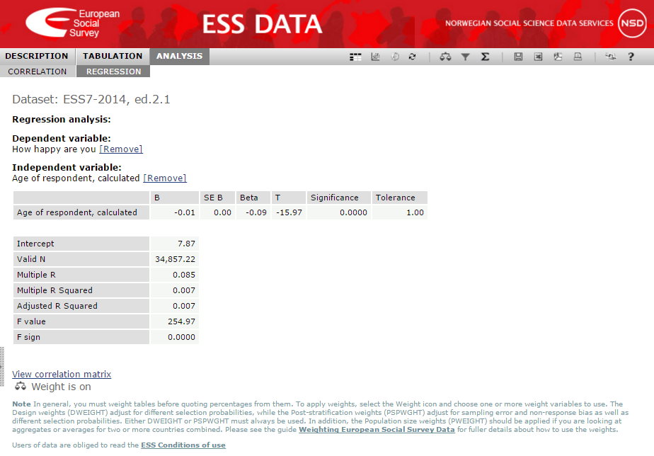

ESSentials: Advanced Data Analysis
Correlation Analysis
Regression
Analysis
Notes:
Correlation
Regression

Slide 13
ESS Impact: Users
Notes:
As at August 2018
NSD Data

Slide 14
ESS Impact: Publications
Publications overall: 3,554
Journal articles: 1,661
Books & chapters: 559
Working papers: 443
Conference papers: 708
Notes:
MALNAR, University of Ljubljana

Slide 15
Ukrainian participation in ESS
Ukraine was a member of the ESS from 2004-13
Took part in 5 Rounds (Rounds 2-6)
1,562 Registered Users of the data (22nd highest)
64.3% of users are students
17.9% of users are faculty or research
Ukraine features in 24.8% of all ESS referenced academic publications (2003-16)
Notes:
August 2018
Higher than Israel

Slide 16
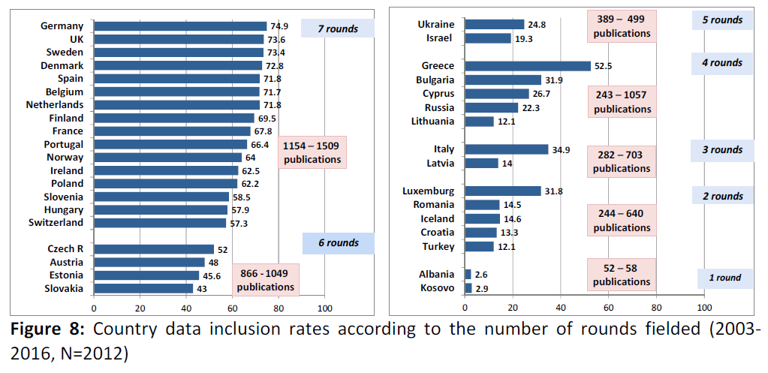
Ukrainian participation in ESS
26th highest number of publications
Notes:
Malnar

Slide 17
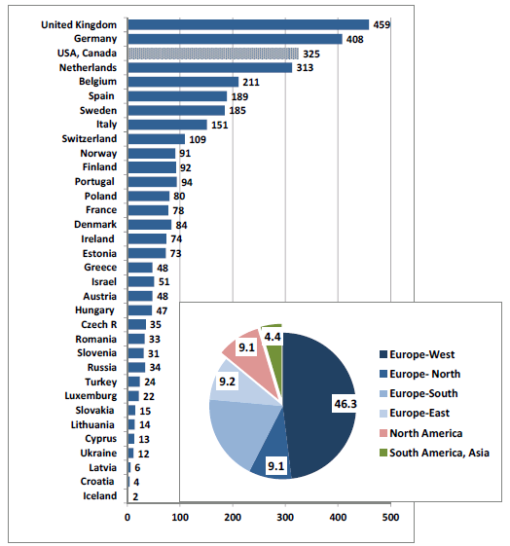
Ukrainian participation in ESS
Country (or region) of first author’s institutional affiliation (2003-2016, N=3554)
The 3554 ESS publications were coded for the country of 1st author’s affiliation.
Authors are affiliated in organizations based in 53 countries and international institutions (e.g. OECD).
Notes:
Malnar

Slide 18
Ukraine in Europe: Findings

Slide 19
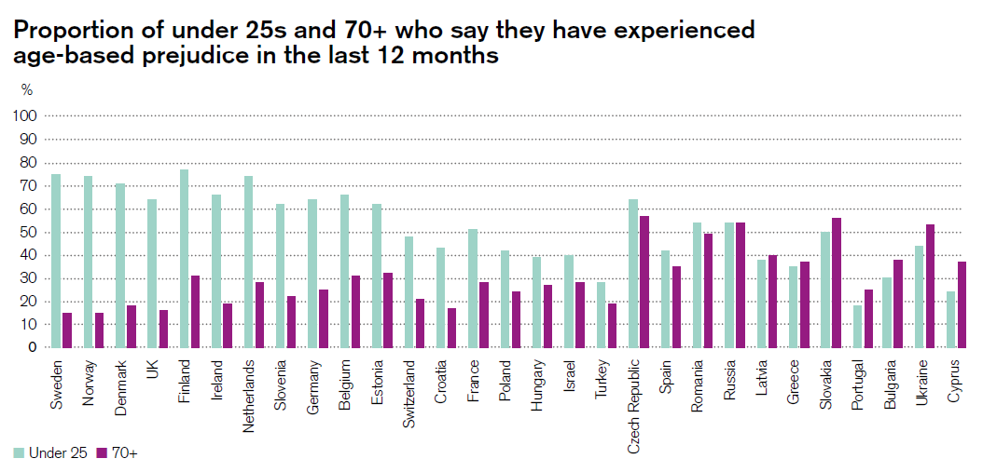
Ukrainian results: Ageism
Over 40% of Ukrainians aged under 25 and over 50% of those aged over 70 experienced age-based prejudice (ESS4)

Slide 20
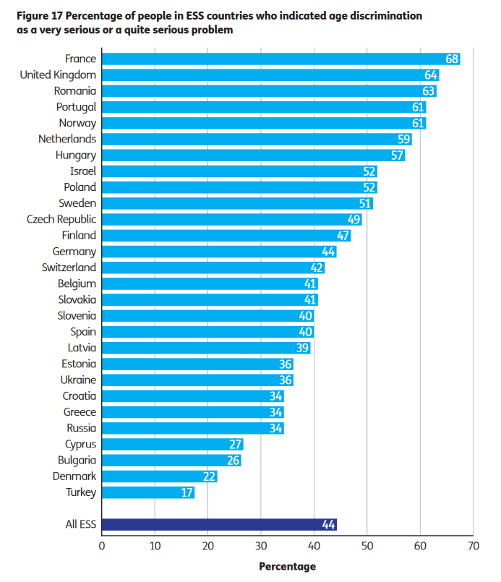
Ukrainian results: Ageism
8th lowest number of respondents (36%) who think age discrimination is a serious problem (ESS4)

Slide 21
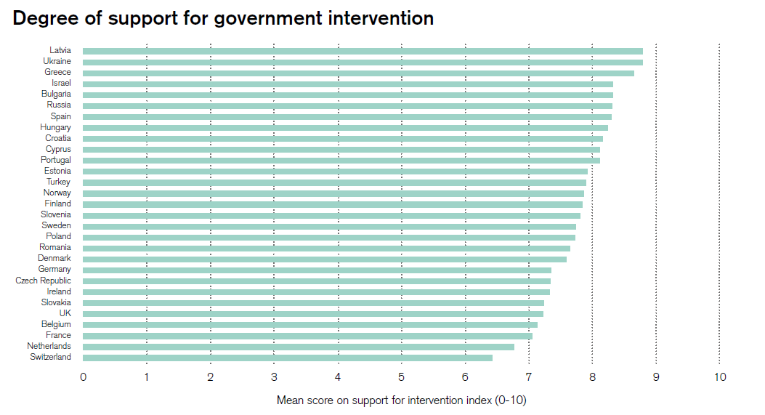
Ukrainian results: Welfare
Government intervention (healthcare support, benefits, pensions, etc.) is broadly supported across Europe (ESS4)
Notes:
UA is the 2nd most supportive of Government intervention amongst 29 European Social Survey countries

Slide 22
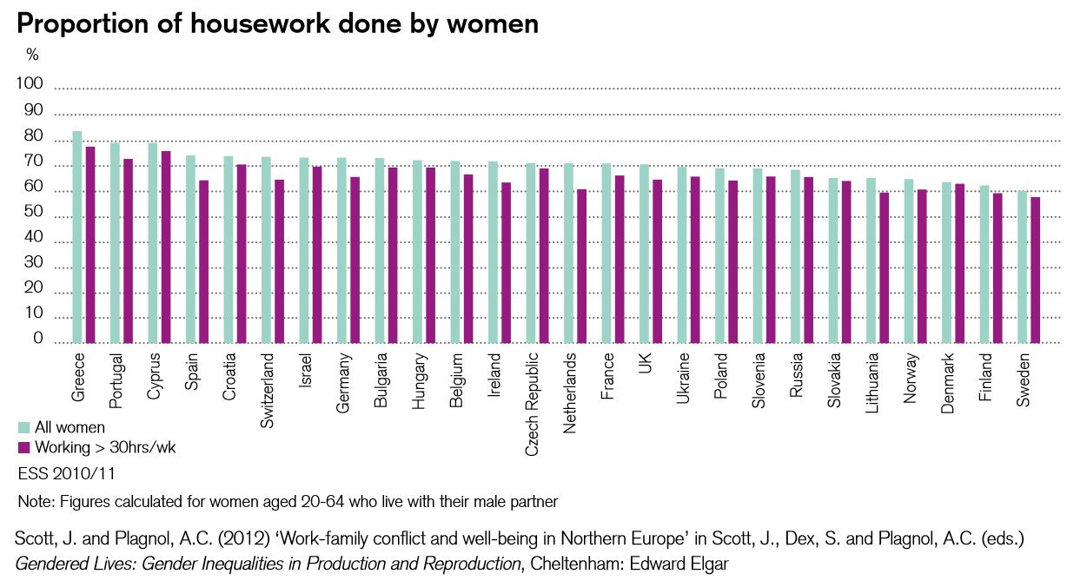
Ukrainian results: Gender
As with all of Europe, women tend to do a higher proportion of housework than men (ESS5)

Slide 23
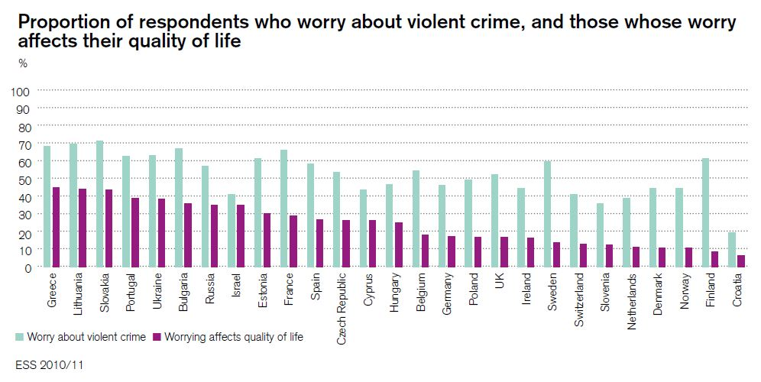
Ukrainian results: Crime
One of the most concerned about violent crime in Europe (ESS5)
Notes:
Of 27 Round 5 countries

Slide 24
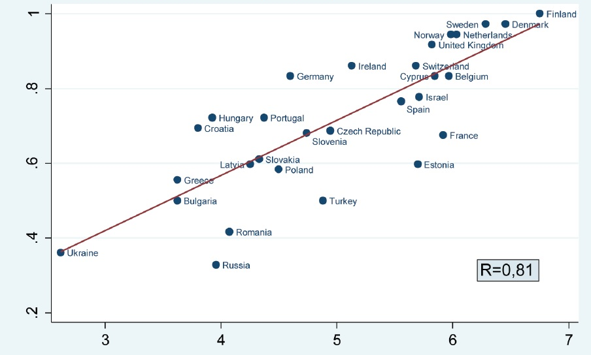
Ukrainian results: Democracy
Perceived quality of Government: Experts v Public (ESS4)
Notes:
This plots ESS findings from four questions, measuring the perceived quality of Government (landscape) on a 0-10 scale
This measure is plotted against three measures: the International Country Risk Guide indicator of Quality of Government (ICRG), the Transparency International Corruption index, and the World Bank Estimate of Government Efficiency
Countries in the top right corner indicate perception of high government quality both among experts and among the public
In the bottom left corner we find a number of countries which are judged as having low government quality by both the public and experts.

Slide 25
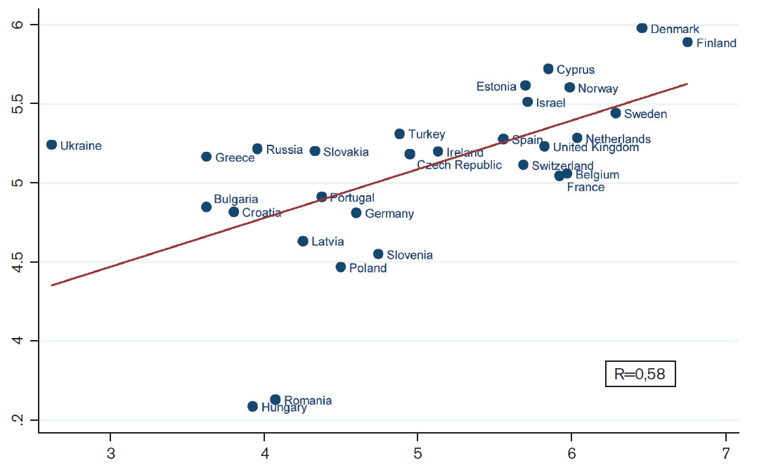
Ukrainian results: Democracy
Perceived quality of Government: Spending v Public (ESS4)
Notes:
Similarly, this one plots the same perceived quality of Government measure (landscape) as the previous slide
But this time the measure is plotted against another measure using items from the ESS: attitudes to tax and spend.

Slide 26
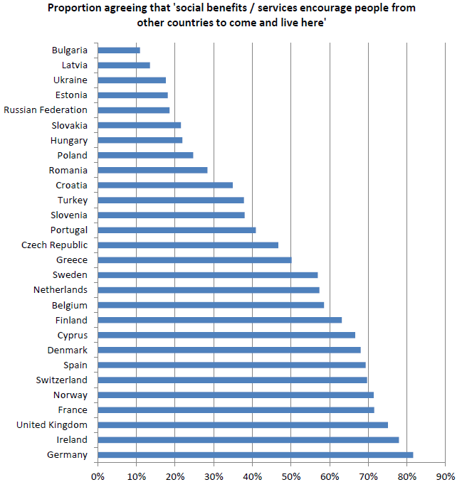
Ukrainian results: Immigration
Ukraine has less concern than many other countries in Europe about social benefits encouraging people from other countries to go and live there (ESS4)
Notes:
10/28 least concern

Slide 27
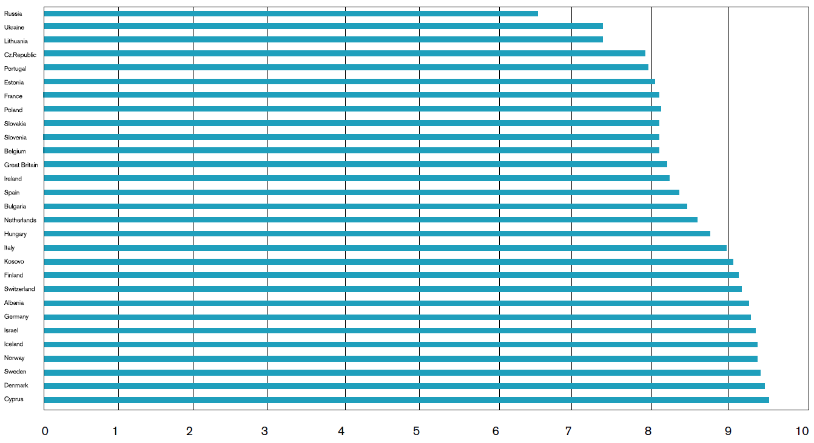
Ukrainian results: Democracy
Importance of living in a democratic country (0-10) (ESS6)
Notes:
Analysis by Mónica Ferrin and Hanspeter Kriesi found that, of the 29 countries who took part in Round 6 (2012/13)…
Cypriots scored highest with 9.5.
Russia values the importance of living in a democratic country the least, with 6.5/10.

Slide 28
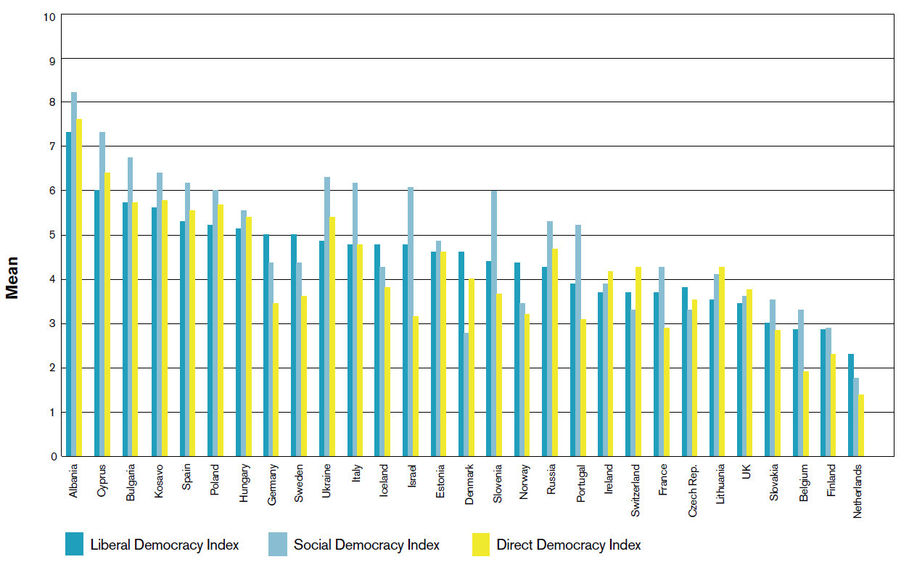
Ukrainian results: Democracy
Mean score on democracy indices (0-10), by country (ESS6)
Notes:
Mónica Ferrin and Hanspeter Kriesi used our data to measure the perceived importance of democracy, using three indices (liberal, social and direct) that pooled 15 ESS questions to develop mean scores.
Liberal Democracy Index = 12 ESS items (Equality before the law, Free and fair elections, Checks and balances on government power, Justification of decisions by government, Media reliability, Retrospective accountability via elections, Protection of minority rights, Media freedom, Opposition free to criticise government, Differentiated parties, Participation in political discussion, Responsiveness to other EU governments)
Social Democracy Index = 2 ESS items (Protection against poverty, Reduced income inequality)
Direct Democracy Index = 1 ESS item (Citizen participation via referendums)
Albania scored higher than all other countries on all three dimensions, followed closely by Cyprus, Bulgaria and Kosovo.

Slide 29
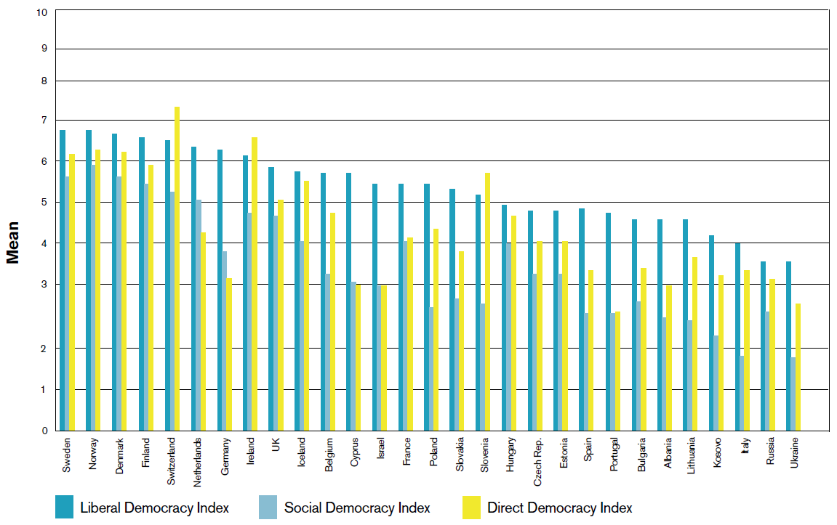
Ukrainian results: Democracy
Mean score on evaluation indices (0-10), by country (ESS6)
Notes:
Having looked at the ideal democracy, Ferrin and Kriesi then sought the evaluation of the democracy respondents live in, again using the thee indices.
Liberal Democracy Index = 12 ESS items (Equality before the law, Free and fair elections, Checks and balances on government power, Justification of decisions by government, Media reliability, Retrospective accountability via elections, Protection of minority rights, Media freedom, Opposition free to criticise government, Differentiated parties, Participation in political discussion, Responsiveness to other EU governments)
Social Democracy Index = 2 ESS items (Protection against poverty, Reduced income inequality)
Direct Democracy Index = 1 ESS item (Citizen participation via referendums)
In the evaluation, rather than the desirable, Albania is at the other end of this graph, with only those from Lithuania, Kosovo, Italy, Russia and Ukraine deeming their democracies weaker.

Slide 30
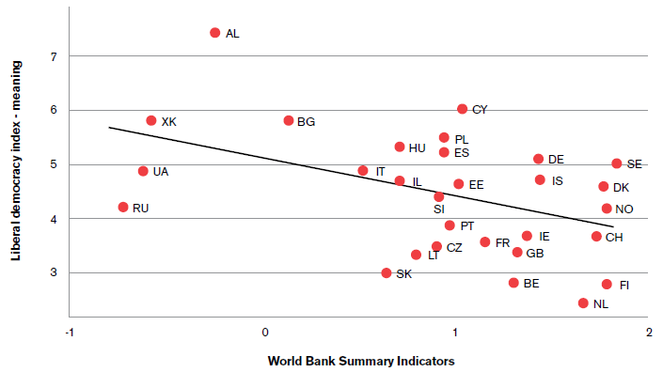
Ukrainian results: Democracy
Correlation between the meaning attached to democracy (ESS) and democratic performance (World Bank indicators) (ESS6)
Notes:
This is a correlation between the meaning attached to democracy (as measured by the ESS liberal democracy index: importance) and democratic performance (as measured by World Bank indicators of the quality of governance).
The public seem to be more demanding with regard to democracy in countries where the World Bank considers that the quality of governance is low.

Slide 31
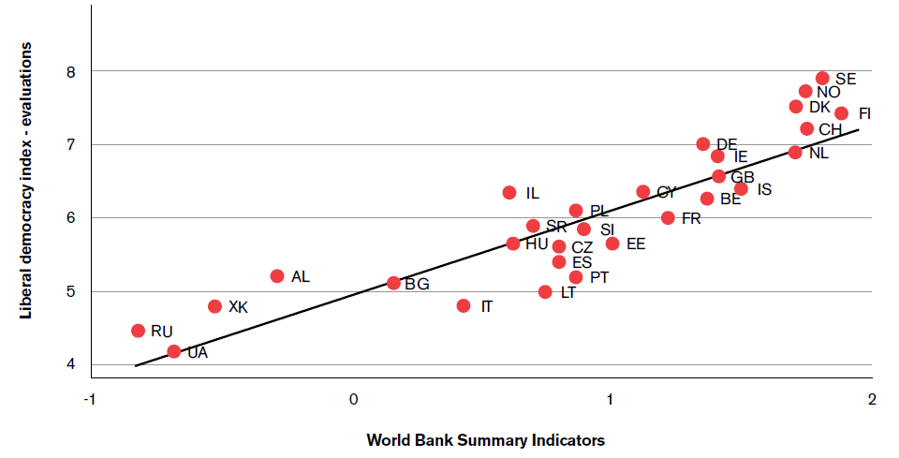
Ukrainian results: Democracy
Correlation between evaluations of democracy (ESS) and democratic performance (World Bank indicators) (ESS6)
Notes:
Correlation between evaluations of democracy (ESS liberal democracy index: evaluation) and democratic performance (World Bank indicators of the quality of governance).
There is a positive relationship between established indicators of democratic performance and Europeans’ personal evaluations of their democratic systems on the ESS liberal democracy index. This shows that the public evaluation is very similar to the independent World Bank evaluation.
Albania is again towards the left of this graph.

Slide 32
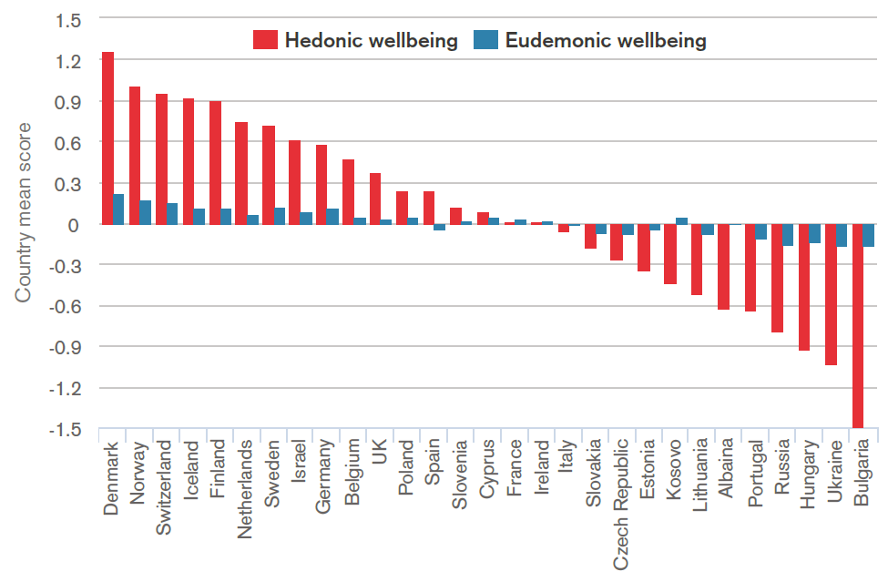
Ukrainian results: Wellbeing
Hedonic and eudemonic wellbeing across Europe (ESS6)
Notes:
Bram Vanhoutte, University of Manchester, used 7 ESS items to develop hedonic and eudemonic wellbeing measures.
Hedonic = The hedonic school of thought, exemplified by Epicurus, believed a good life to be filled with happiness. (2 ESS items: satisfied with life; how happy you are)
Eudemonic = Aristotle proposed eudemonia, or flourishing, living in accordance with your true self, as a way to lead a good life. (5 ESS items: free to decide how to live life; little chance to show how capable I am; daily sense of accomplishment; life is valuable and worthwhile; sense of direction in life).
Albania saw the 6th lowest score for Hedonic wellbeing, but is much more in the mid-range (18th of the 29 countries) when it comes to Eudemonic WB.

Slide 33
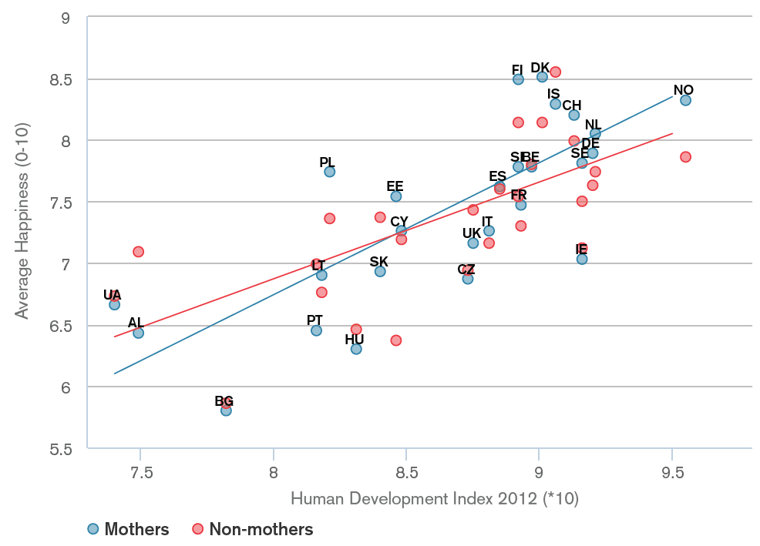
Ukrainian results: Wellbeing
Happiness of mothers and non-mothers by country and
level of development (ESS6)
Notes:
ESS WB figures can also be measured against external figures. This shows ESS happiness levels and the level of development in society reported by the UN Human Development Index (HDI).
There is a positive relationship between the two measures.
Analysis by Arnstein Aassve, Bocconi University, Italy; Letizia Mencarini, University of Turin, Italy; Maria Sironi, University of Oxford, UK

Slide 34
While you’ve been away….

Slide 36
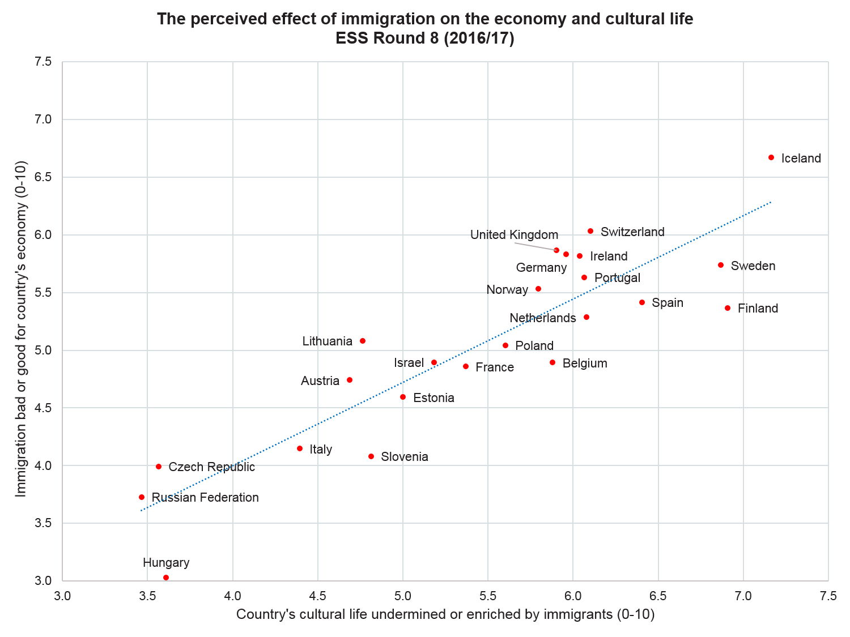

Slide 40
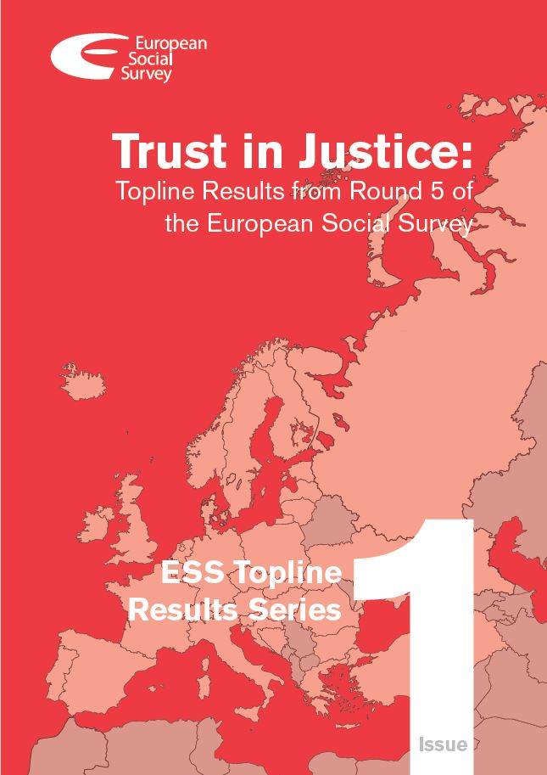
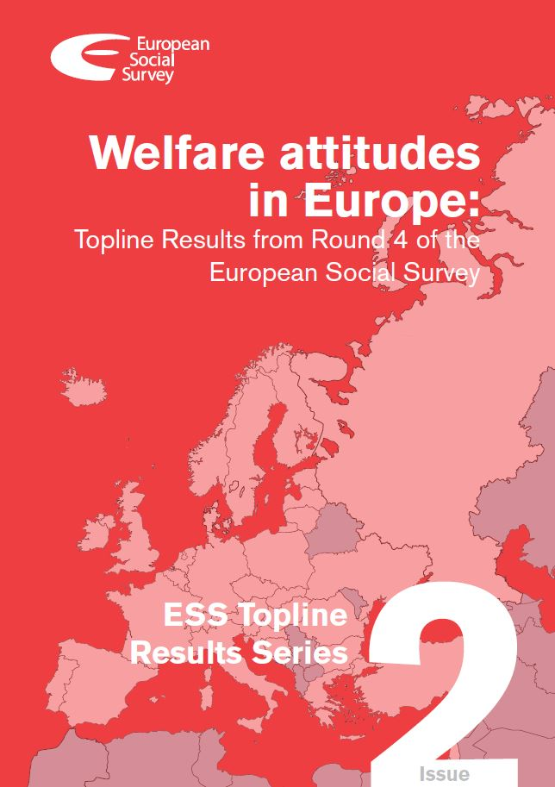
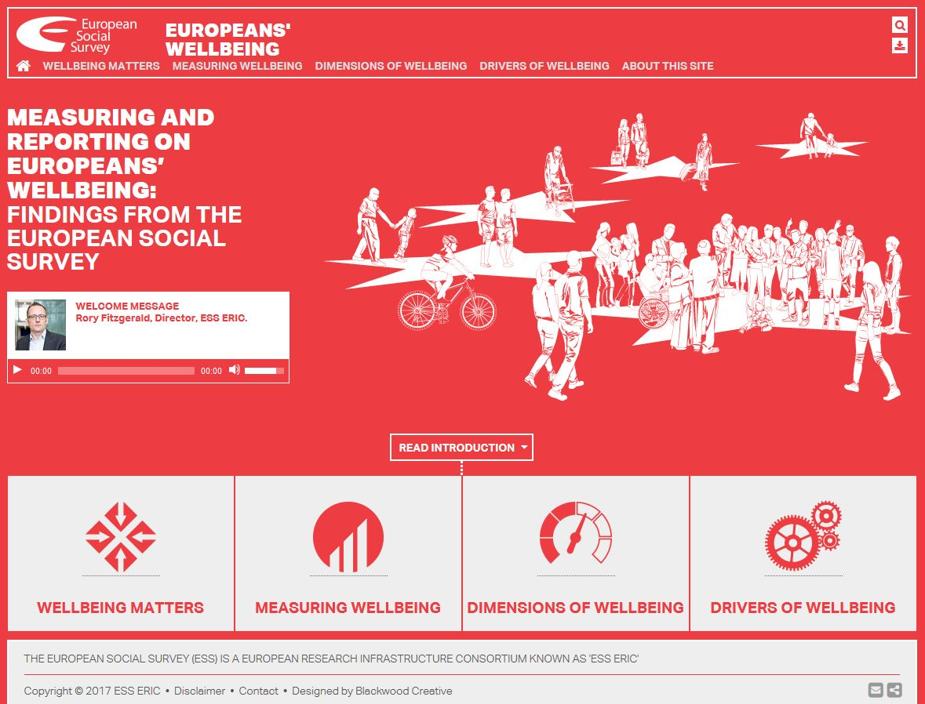
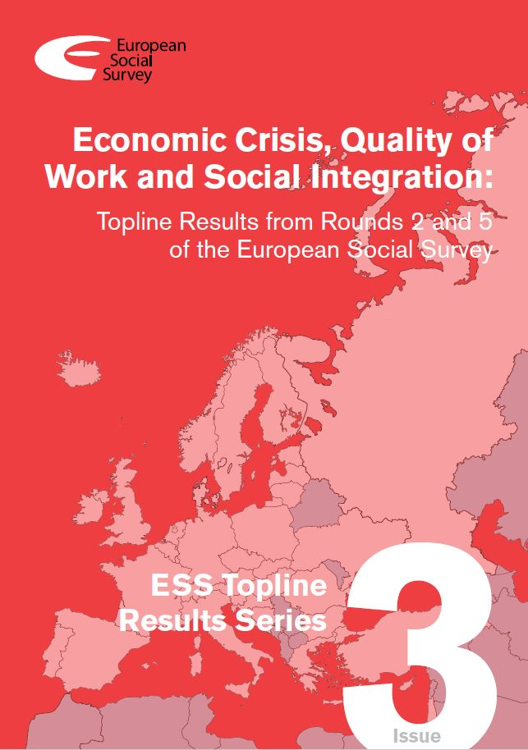
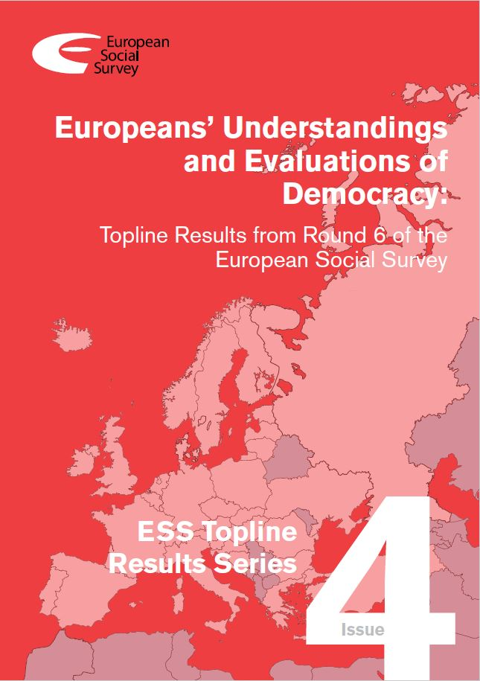
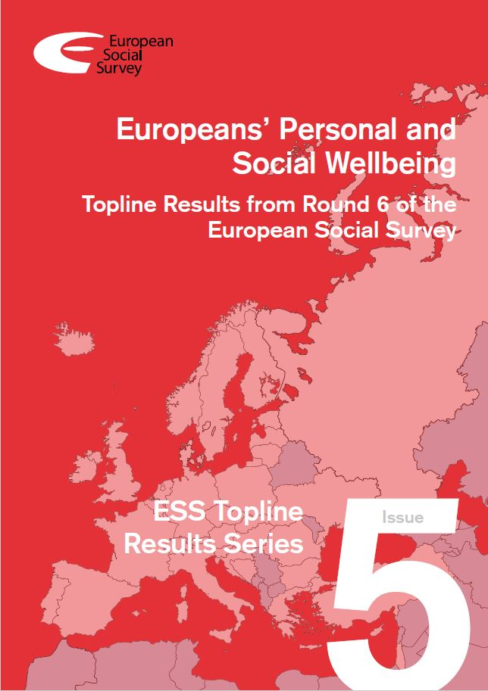
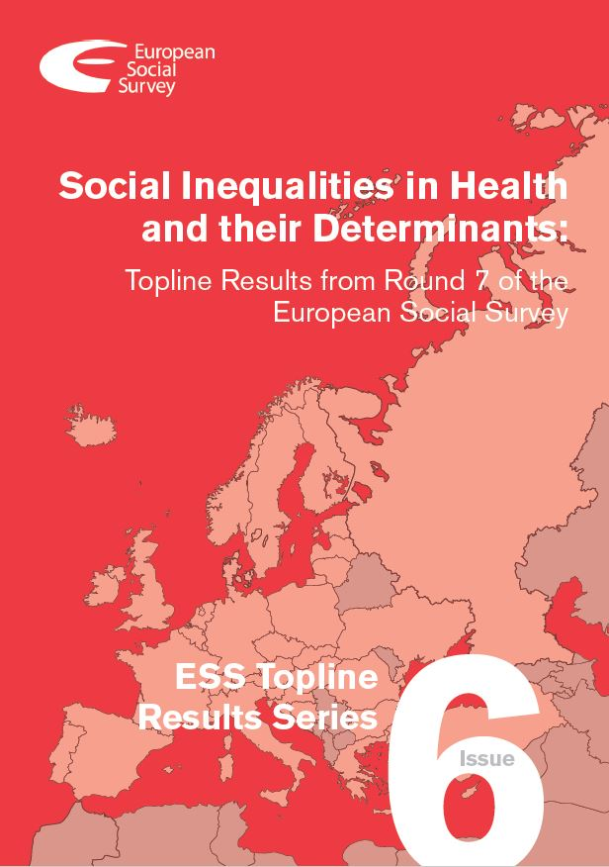
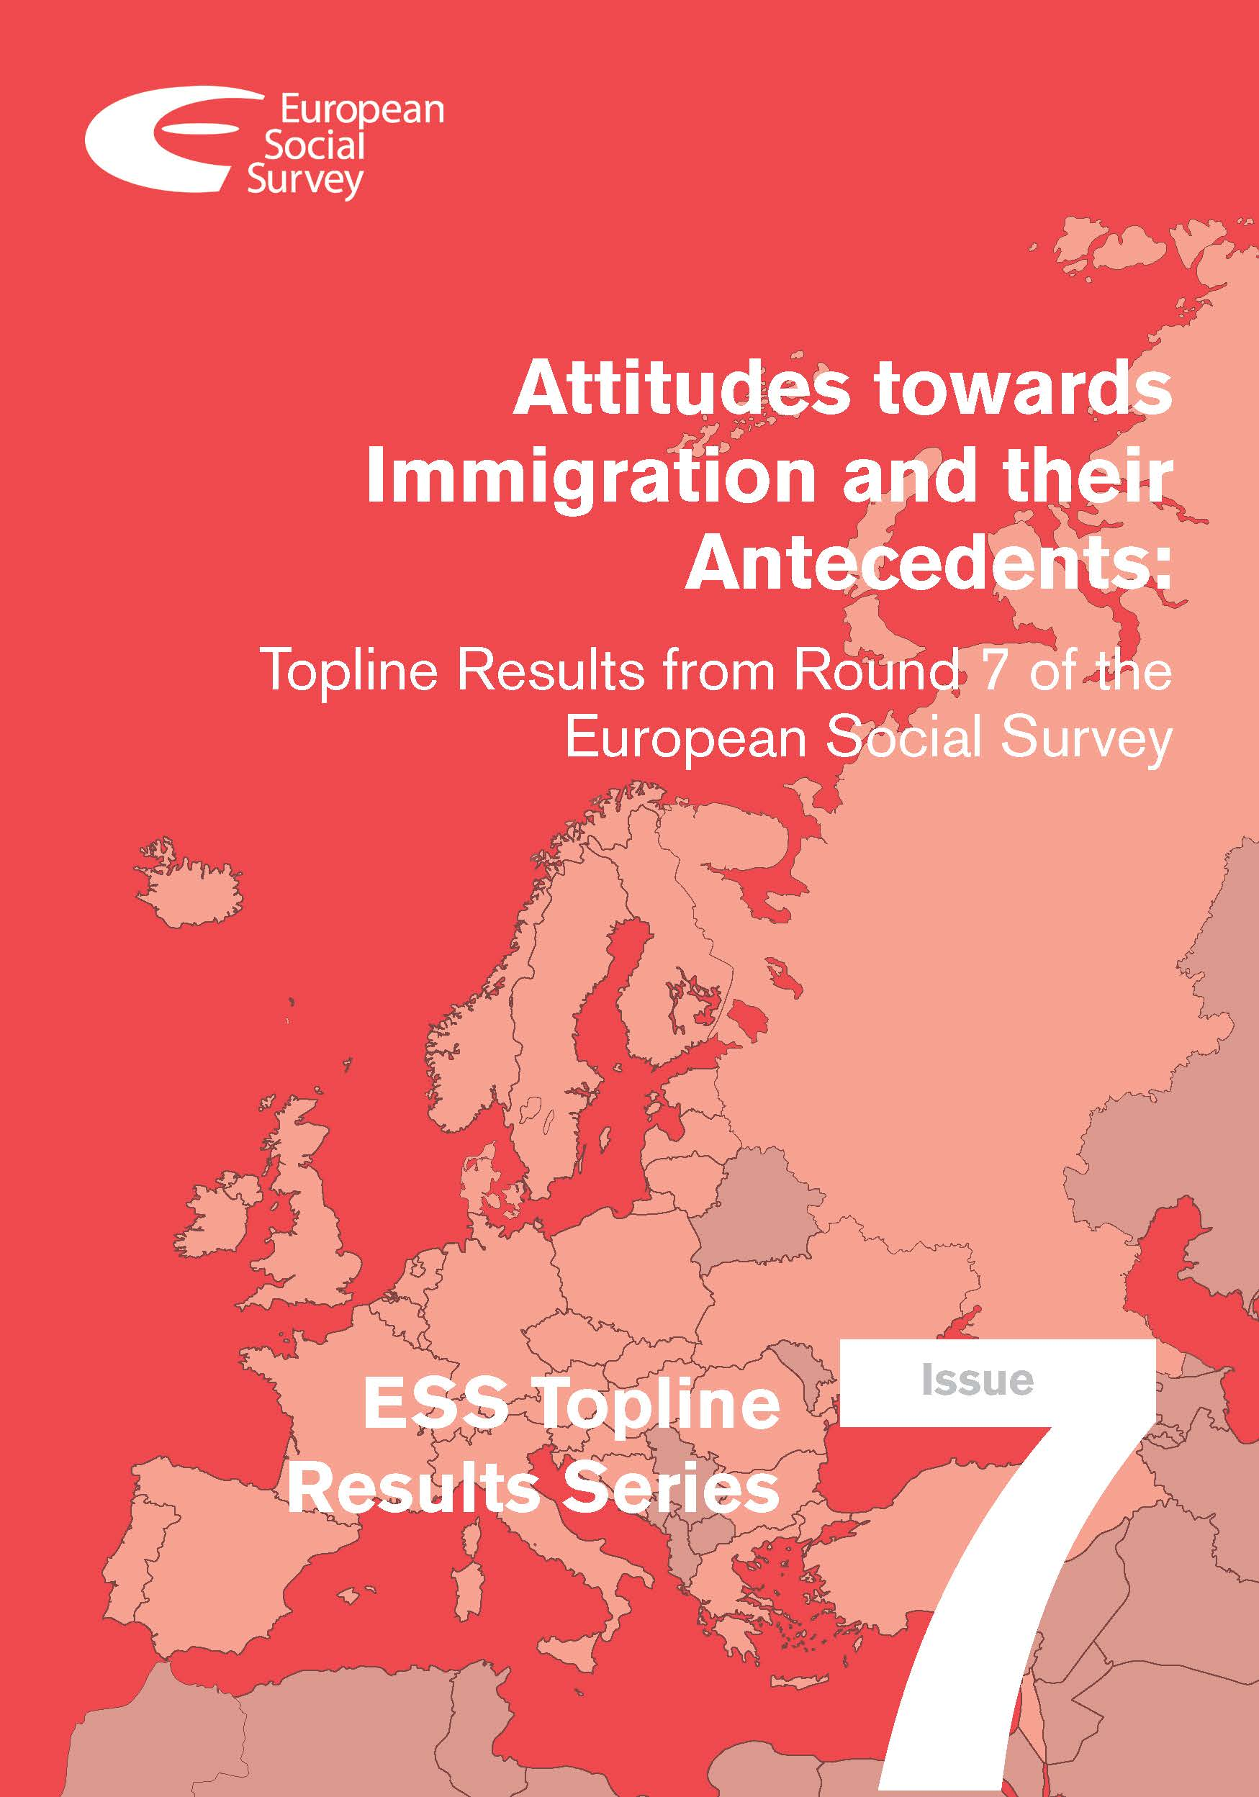


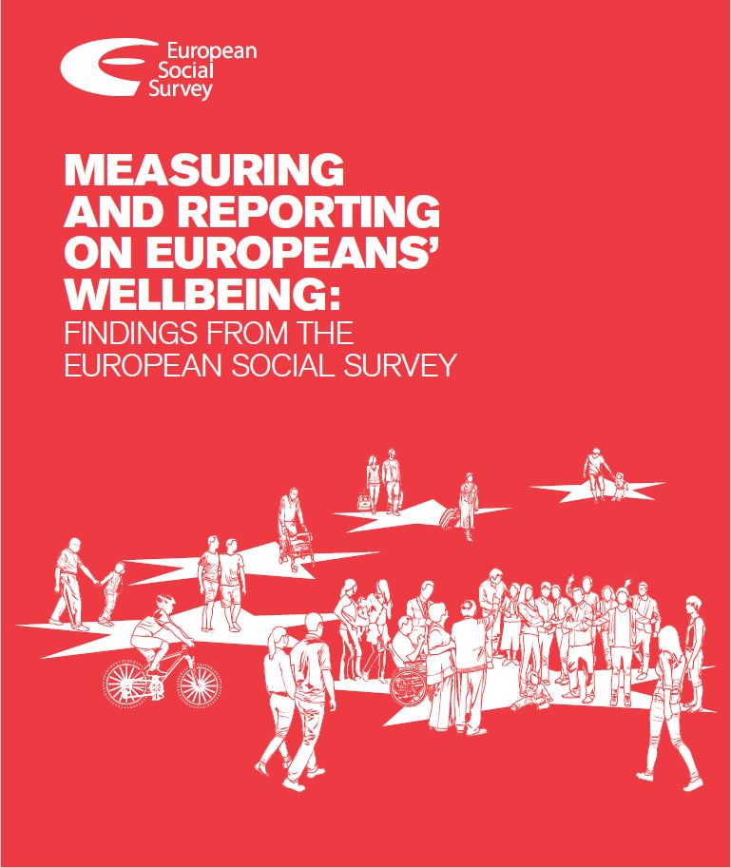
Publications

Slide 41
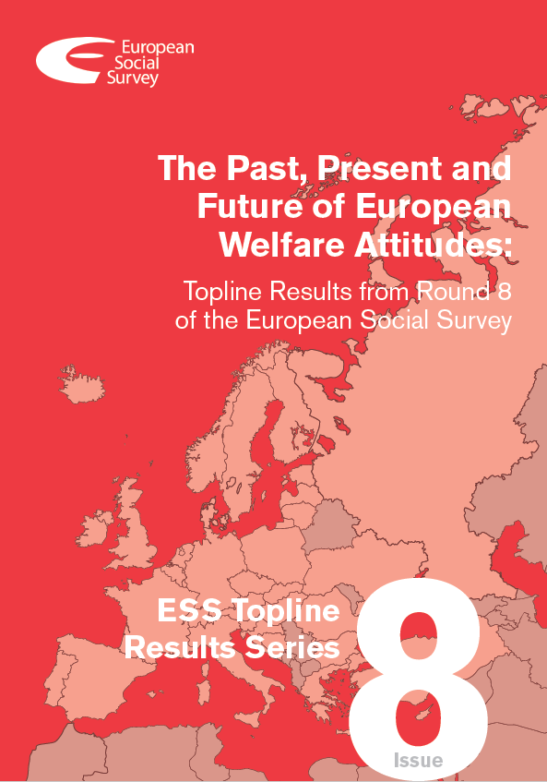
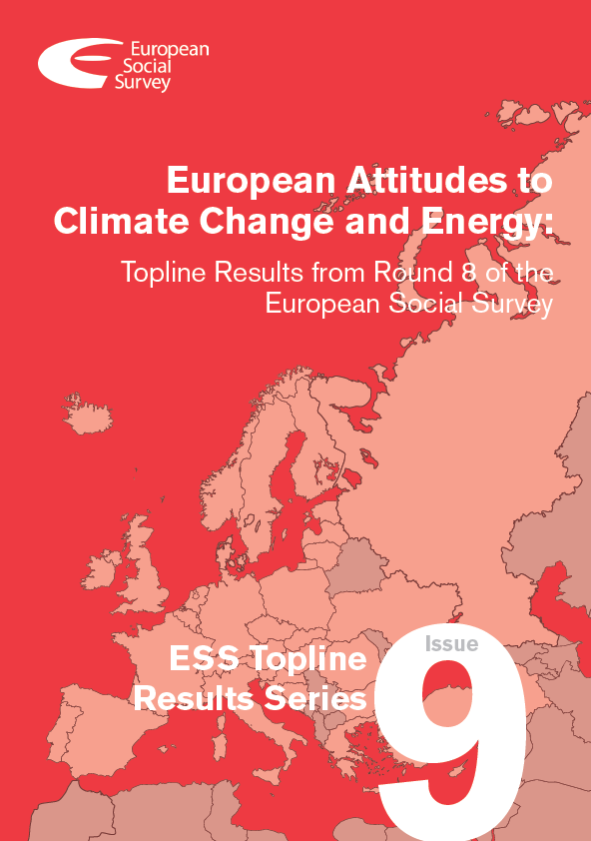
Welfare and Climate Change

Slide 42
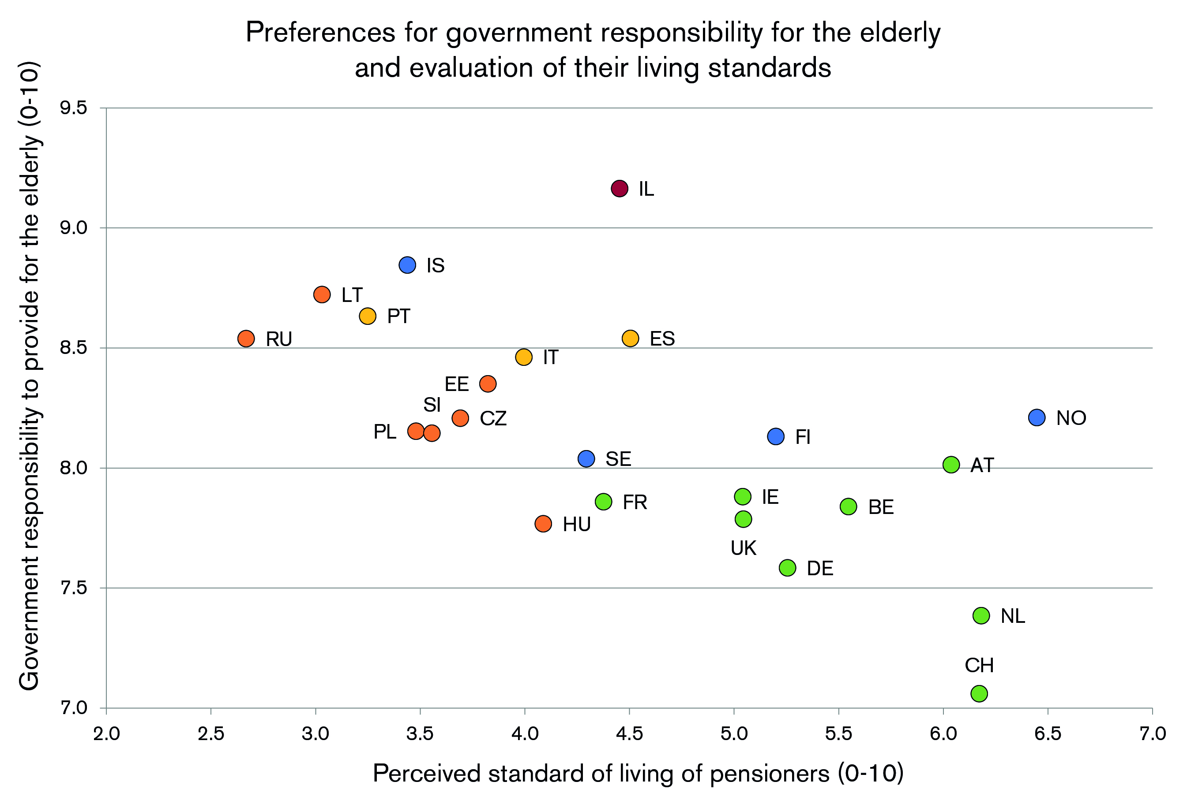

Slide 43
Round 8 results: EU-wide welfare

Slide 44
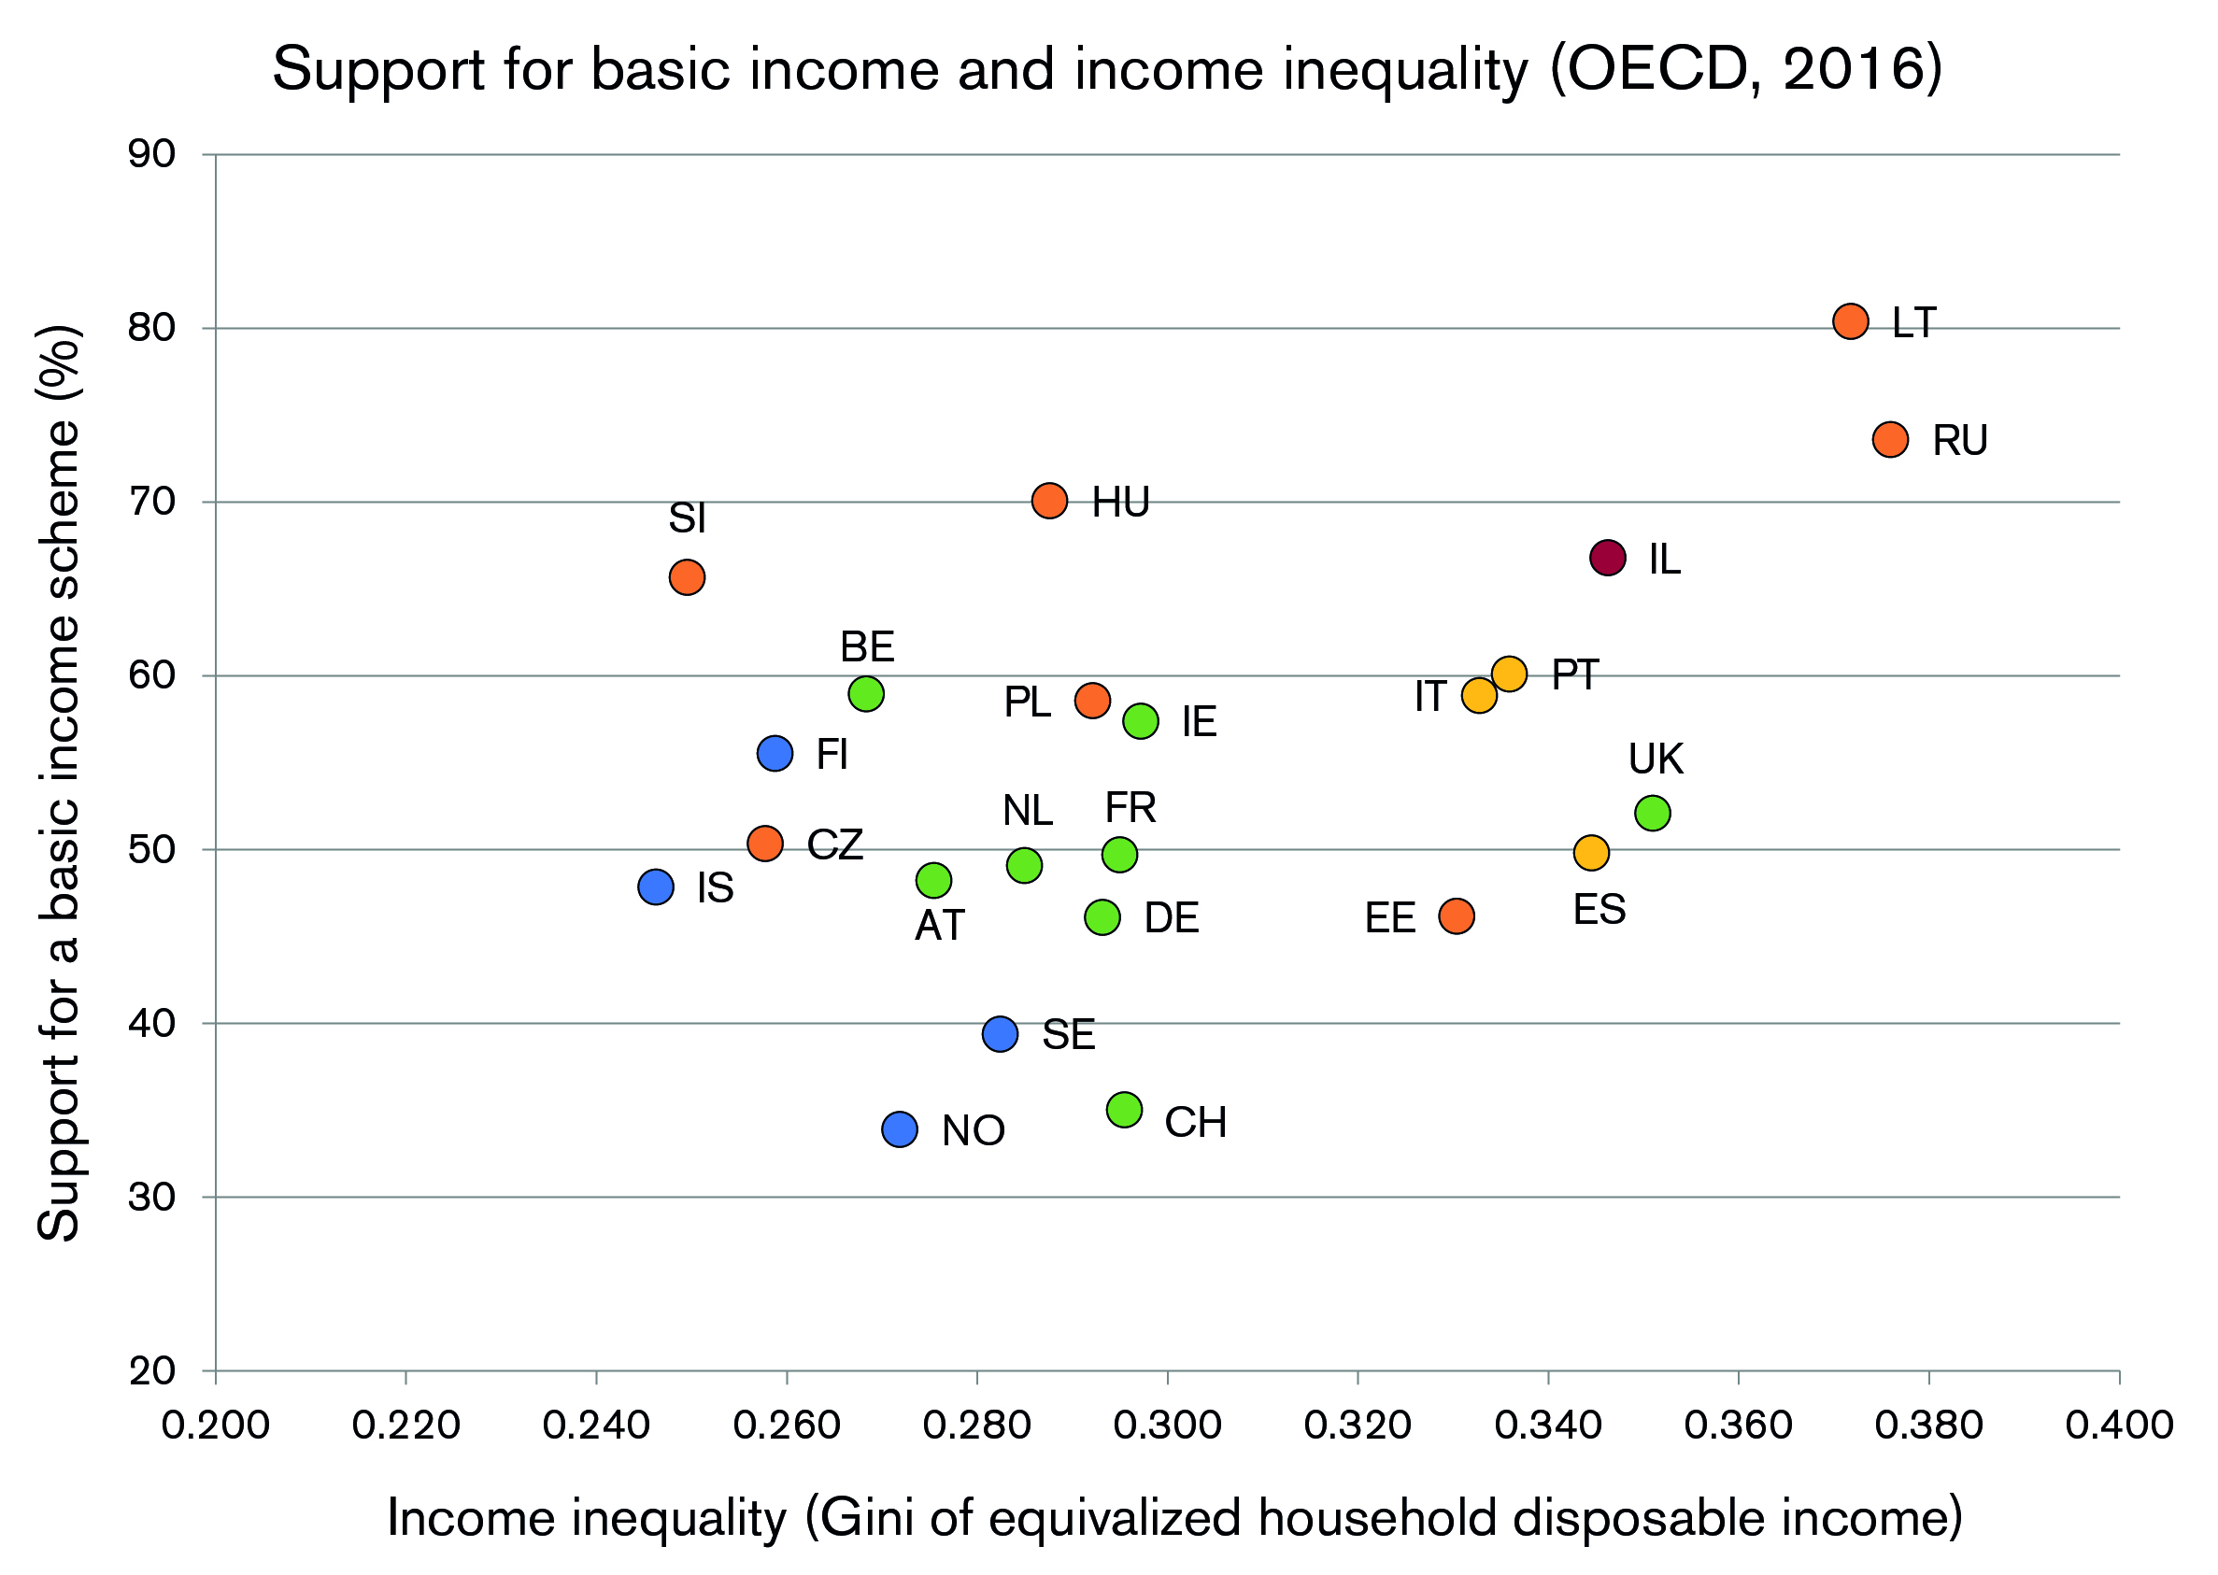

Slide 46
ESS Core Questionnaire (Round 9)
Media use; Internet use; social trust - 6 questions
Political interest, trust, electoral and other forms of participation, party allegiance, socio-political orientations, immigration - 43 questions
Subjective wellbeing, social exclusion, crime, religion, perceived discrimination, national and ethnic identity, vote intention in EU referendum - 35 questions
Socio-demographic profile, including: household composition, sex, age, marital status, type of area, education & occupation of respondent, partner, parents, union membership, income and ancestry - 35 questions
Human Values Scale - 21 questions
Notes:
Worth noting that not all questions are asked of all respondents as some questions are supplementary to initial questions, and some are asked in a slightly different way
Human values:
Important to think new ideas and being creative
Important to be rich, have money and expensive things
Important that people are treated equally and have equal opportunities
Important to show abilities and be admired
Important to live in secure and safe surroundings
Important to try new and different things in life
Important to do what is told and follow rules
Important to understand different people
Important to be humble and modest, not draw attention
Important to have a good time
Important to make own decisions and be free
Important to help people and care for others well-being
Important to be successful and that people recognize achievements
Important that government is strong and ensures safety
Important to seek adventures and have an exciting life
Important to behave properly
Important to get respect from others
Important to be loyal to friends and devote to people close
Important to care for nature and environment
Important to follow traditions and customs
Important to seek fun and things that give pleasure

Slide 47
Rotating Modules (Round 9)
Timing of Life (repeated from Round 3)
The life course, timing of key life events, attitudes to ideal age, youngest age and oldest age of life events, life planning - 35 questions
Justice and Fairness (new module)
Political procedural justice, fairness of income, fairness of educational and job opportunities, fairness of the distribution of resources, attitudes toward normative principles, social closure, belief in a just world - 32 questions

Slide 48
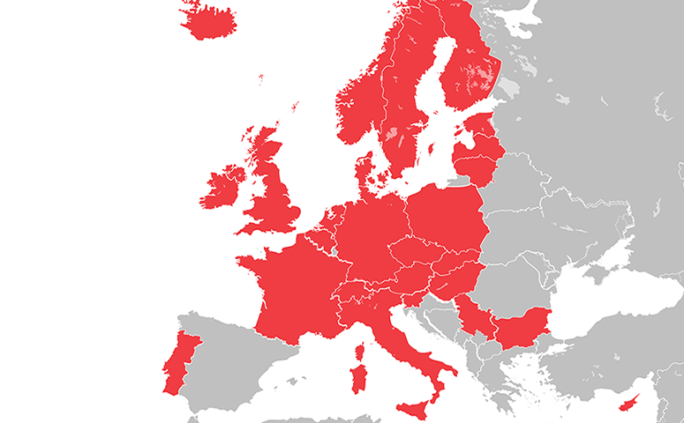
Round 9: Participating countries
Notes:
Countries in ESS red are definitely participating in Round 9 (26):
Members (23): Austria, Belgium, Bulgaria Cyprus, Czech Republic, Estonia, Finland, France, Germany, Hungary, Iceland, Ireland, Italy, Latvia, Lithuania, Netherlands, Norway, Poland, Portugal, Slovakia, Slovenia, Sweden, UK.
We also have 1 Observer country: Switzerland.
There are currently 2 Guest countries for Round 9: Denmark and Serbia.
We think that Israel and Spain are likely participants, whether as Guest or Member countries.
We remain hopeful that some other might also participate (7): Albania, Croatia, Greece, Kosovo, Luxembourg, Romania, Russia and Ukraine

Slide 49
Eric.Harrison.2@city.ac.uk
www.europeansocialsurvey.org
@ESS_Survey
EuropeanSocialSurvey
european-social-survey

