Slide 1



“Experience of participation in EVS and other international projects”
Науковий семінар
«Участь України в Європейському соціальному дослідженні (ESS):
результати для науковців, уряду та політиків»
September, 20th , 2018
Olga Balakireva,
Department of the Monitoring Studies of Socio-Economic Transformations,
The Institute for Economics and Forecasting of the NASU

Slide 2

http://www.europeanvaluesstudy.eu/
Home
About EVS
Research Topics
Previous Surveys 1981-2008
Survey 2017
Dissemination Activities
Collaboration with WVS
Data and Downloads
Online analysis
Maps
Education
Publications
News and Events
The European Values Study is a large-scale, cross-national, and longitudinal survey research program on basic human values. It provides insights into the ideas, beliefs, preferences, attitudes, values and opinions of citizens all over Europe. It is a unique research project on how Europeans think about life, family, work, religion, politics and society.
The European Values Study started in 1981, when a thousand citizens in the European Member States of that time were interviewed using standardized questionnaires. Every nine years, the survey is repeated in a variable number of countries.
The fourth wave in 2008 covers no less than 47 European countries/regions.
In total, about 70,000 people in Europe are interviewed.

Slide 3
http://www.europeanvaluesstudy.eu/
Home
About EVS
Research Topics
Previous Surveys 1981-2008
Survey 2017
Dissemination Activities
Collaboration with WVS
Data and Downloads
Online analysis
Maps
Education
Publications
News and Events
The data of the European Values Study are available free of charge. A rich academic literature has been created around the original and consecutive surveys and numerous other works have made use of the findings: more than 1600 publications are listed in the EVS Bibliography.
In-depth analyses of the 1981, 1990, 1999, and 2008 findings with regard to Western and Central Europe reinforced the impression that a profound transformation of modern culture is taking place, although not at the same speed in all countries.
Cultural and social changes appear dependent upon the stage of socio-economic development and historical factors specific to a given nation.
The new 2017 wave will provide further insights in this matter, also allowing analyses of the impact of the economic crises on the Europeans' values.

Slide 4
http://www.europeanvaluesstudy.eu/
About EVS
History
Organization
Participating countries
Sponsoring and funding
Contact
The European Values project is managed by the Council of Program Directors; who discuss the general outlines of the project and approve the final questionnaire and the survey method. All daily responsibilities are delegated to the Executive Committee. The questionnaire is developed by the Theory Group; the quality of the project is taken care of by the Methodology Group. The EVS Foundation aims at planning and promoting joint activities and offers assistance in fund raising, like finding sponsors.
Council of program directors
Executive Committee
Theory group
Methodology group
Board of EVS foundation
Sponsors and funding
Communication
Operational and Planning Group

Slide 5
http://www.europeanvaluesstudy.eu/
Sponsoring and funding
Sponsors of the 2008 survey
Major sponsor of the surveys in Central and Eastern European countries - Renovabis (Solidaritätsaktion der deutschen Katholiken mit den Menschen in Mittel- und Osteuropa): Projectnr. MOE016847
Armenia
European Values Study (EVS) Foundation, Department of Sociology, Tilburg University
Renovabis
Austria
Austrian federal Ministry of Science and Research
Azerbaijan
European Values Study (EVS) Foundation, Department of Sociology, Tilburg University
Renovabis
Belarus
European Values Study (EVS) Foundation, Department of Sociology, Tilburg University
Renovabis
Belarus State University

Slide 6
http://www.europeanvaluesstudy.eu/
Sponsoring and funding
Sponsors of the 2008 survey
Finland
The Church Research Institute
France
Comité interministériel de concertation pour les données en sciences sociales
Agence nationale pour la recherche (ANR "Corpus et outils de la recherche en sciences humaines et sociales")
Service d'information du gouvernement (SIG)
Ministère de l'economie, des finances et de l'emploi
Ministère de l'immigration, de l'intégration, de l'identité nationale et du co-développement
Ministère des Affaires étrangères et européennes
Direction de la recherche, des études, de l'évaluation et des statistiques (DREES-Mire), Ministère de la Santé, de la jeunesse et des sports
Institut national de la jeunesse e de l'éducation populaire (INJEP)
Région Rhône-Alpes-Recherche (cluster 12)
Laboratoire PACTE (IEPG/CNRS) et Institut d'études politiques de Grenoble
Institut d'études politiques de Bordeaux
Institut d'études politiques de Paris
Fondation Hippocrène

Slide 7
http://www.europeanvaluesstudy.eu/
Sponsoring and funding
Sponsors of the 2008 survey
The Netherlands
The Netherlands Organisation for Scientific Research (NWO): Grant number: 471-07-001
Northern Ireland
European Values Study (EVS) Foundation, Department of Sociology, Tilburg University
St. Stephen's Green Trust
Norway
Research Council of Norway
Poland
Ministry of Science and Higher Education in Poland; Project Nr N N116 0280 33, Decision Nr 0280/H03/2007/33, University of Warsaw GR-2578
Foundation of the European Values Study
Renovabis
Ukraine
European Values Study (EVS) Foundation, Department of Sociology, Tilburg University
Renovabis
Institute for Economy and Forecasting National Academy of Science of Ukraine (Department for Monitoring of the Social-Economic Process)

Slide 8

Proposed cooperation agreement between the European Values Study and World Values Survey Association regarding joint implementation of the values surveys in 2017 in Europe
§1 Objective
The object of this agreement is the cooperation between the European Values Study (EVS) and the World Values Survey Association (WVSA) for joint data collection in 2017. The two organizations agree to collaborate in carrying out a single, shared EVS/WVS survey in Europe.

Slide 9
Collaboration with WVS
The European Values Study and the World Values Survey agreed to collaborate in carrying out the 2017 values survey in Europe as defined in the Memorandum of Understandings.
In line with this agreement, both organizations coordinated the questionnaire’s design and the overlap in the two questionnaires is about 70%. In all European countries, the EVS questionnaire is applied and data collection is coordinated by EVS according to the strict methodological guidelines prepared by EVS Methodology Group that are specifically adapted to the European context.
A Joint Liaison Committee has been established with the aim of ensuring regular communication and coordination of common activities between the two organizations.
The collaboration takes place in different forms and this Table resumes them.

Slide 10
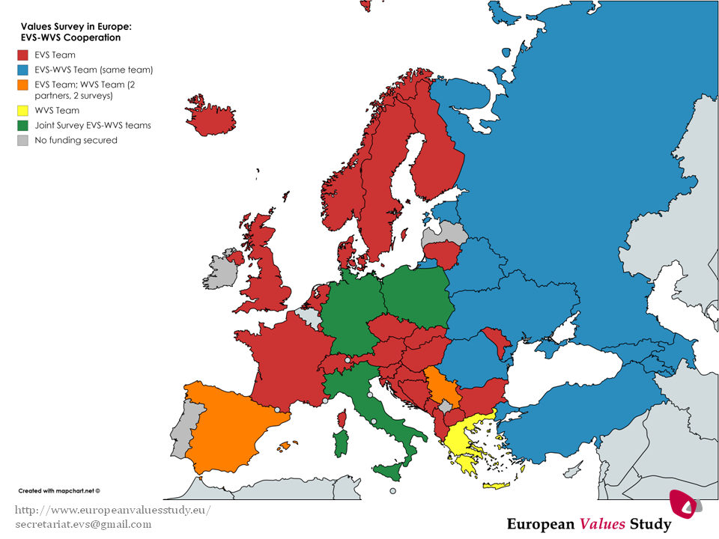

Slide 11
http://www.europeanvaluesstudy.eu/
Previous Surveys 1981-2008
The four waves of the European Values Study
For more information on study design, fieldwork procedure, and available data and documentation, go to:
1981 - 1st EVS wave (16 countries)
1990 - 2nd EVS wave (29 countries)
1999 - 3rd EVS wave (33 countries)
2008 - 4th EVS wave (47 countries/regions – 65 languages)
The EVS longitudinal data files 1981-2008
EVS Longitudinal Data File 1981-2008: Cumulative dataset based on the four EVS waves 1981, 1990, 1999, and 2008 (48 countries/regions)
Integrated Values Surveys 1981-2014: Information on how to create a data file including the four EVS waves and the six WVS waves (113 countries/regions)

Slide 12
http://www.europeanvaluesstudy.eu/
Survey 2017
Methodology
* Respondents are interviewed face-to-face for approximately one hour. However in the 5th wave of EVS there is the possibility to carry out a mixed-mode data collection.
* The Countries translated the Master Questionnaire following a team approach. The process was managed, implemented and documented on a web-based platform, the Translation Management Tool (TMT).
* In each Country, the Master Questionnaire was translated in each language spoken by at least 5% of the population.
* Countries sharing a language (e.g. French, German, Russian) cooperated for the harmonization between the same-language translations of the EVS2017 questionnaire. Some countries cooperated in the whole translation process, in other cases one country’s translation was used as a basis for the other countries’ questionnaires.

Slide 13
http://www.europeanvaluesstudy.eu/
Survey 2017
Methodology
* The national effective sample size is 1200 [countries with population over 2 million] and 1000 [countries with population above 2 million].
* Random samples give full coverage of the target population (persons 18 years and older resident in private households, regardless of nationality or language).
* Information is provided for weighting purposes, including the complete hierarchical structure of the sampling design, the size of the stages/clusters at each step, population distributions, and so on.
* Repeated revisits are made to interview the person randomly selected.
* The questionnaire contains pre-classified variables for education, income, political parties, religion, and region, and open questions for occupation, nationality, and language, which are coded according to pre-classified country-comparable classifications.
* Quality control checks are carried out and documented on a sample of respondents, refusals and non-contacts.

Slide 14
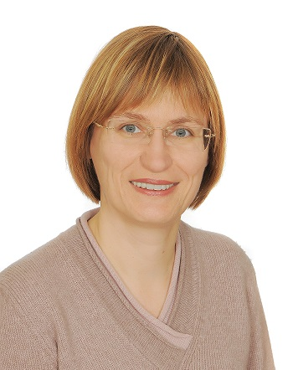
http://www.europeanvaluesstudy.eu/
New Chair of the EVS Assembly
Starting with September 2018, Ruta Ziliukaite acts as new Chair of the EVS Assembly.
The EVS Assembly consists of the Full Partners of EVS. The EVS Assembly is the highest scientific authority of EVS. It decides strategic questions of long-term relevance, including the mandatory methodological standards to be followed in conducting the survey, the Partnership fees, the planned budget, the financial accounts report delivered by the Executive Committee, accession, status and termination of Partnership for associate and full Partners, and changes to these statutes. In this last case a quorum of two-thirds of all Full Partners is needed.
Ruta Ziliukaite is Assoc. Professor in Sociology and Director of the Institute of Sociology and Social Work at the Faculty of Philosophy, Vilnius University.
She became a member of the Lithuanian EVS team in 1999, and since 2008 she is the EVS Program Director in Lithuania. Her research interests concern political and religious values, with a particular focus on intergenerational value differences in Lithuanian society.

Slide 15
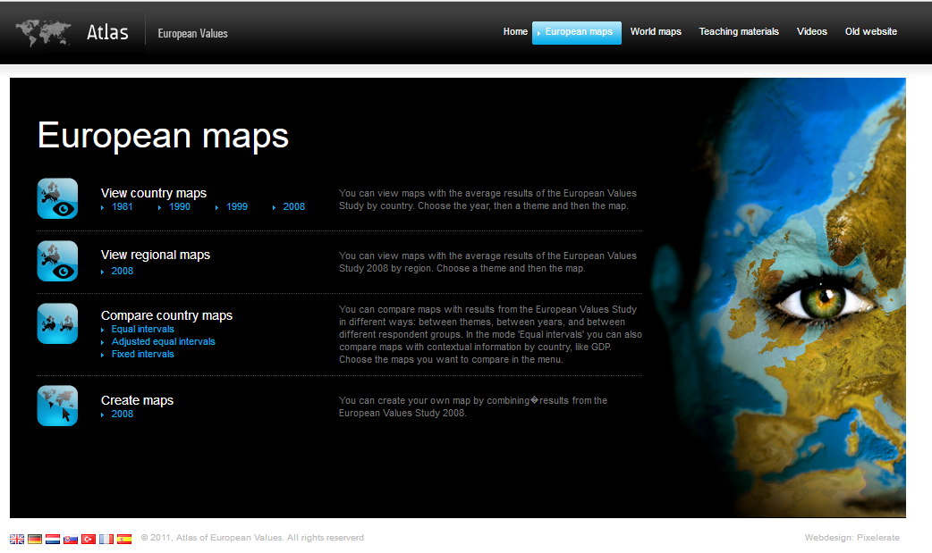
http://www.europeanvaluesstudy.eu/page/atlas-of-european-values.html
Maps
The Atlas of European Values allows creating informative maps for comparisons among countries and waves. EVS provides you with a reliable tool to follow the value change in Europe between 1981 and 2008.

Slide 16
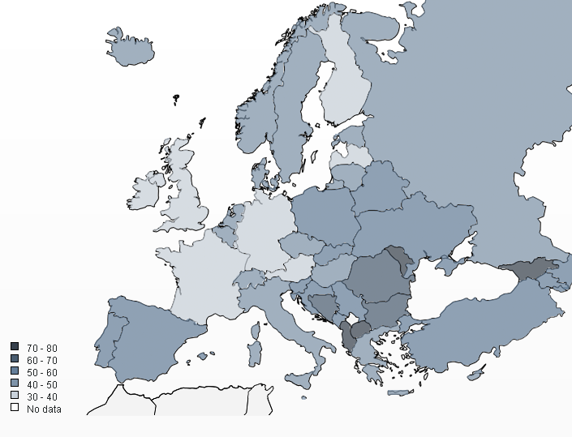
Data and documentation of the EVS waves and the Longitudinal data File 1981-2008 is available for download from the GESIS Data Archive for the Social Sciences.
For information on how to download EVS data and documentation, see
Data and Downloads
https://www.gesis.org/en/home/

Slide 17
http://www.europeanvaluesstudy.eu/
EVS in UKRAINE
Cooperation Agreement
between Stichting European Values Systems Study Group and Institute of Economics and Forecasting of NAS of Ukraine:
… agree as follows:
- IEF is full partner of the Foundation for a period of four years (01-01-2018 to 01-01-2022);
- IEF contributes to the achievement of the objectives of the Foundation;
- The Foundation confers on IEF all rights arising from the Regulations, defined in Appendix I contained in this contract. IEF agrees to comply with the regulations;
- IEF representative to the EVS bodies is Olga Balakireva, Head of the PhD in Sociology, Head of the Department for Monitoring Research on Socio-Economic Transformations;
- IEF owes the Foundation a yearly contribution. For 2018 the contribution is € 100 (One Hundred EURO). The fee for subsequent years is decided each year by the EVS Assembly.

Slide 18
http://www.europeanvaluesstudy.eu/
Survey 2017/2018 in UKRAINE (EVS-WVS Team)
Department of the Monitoring Studies of Socio-Economic Transformations, The Institute for Economics and Forecasting of the NAS has been carrying out preparatory phase seventh wave of the European Values Study (EVS) and World values Study (WVS) projects.
Now the research team is looking for funding for fieldwork stage implementation of survey in Ukraine. Even so, members of the research group have been preparing Survey tools.
Currently, we have completed preparation of the international classifications of the educational levels, political parties, and the income levels.
In addition to this, we are working on questionnaire translations in the TMT system and its review.
Also, research team is setting up a sample framework and its description.

Slide 19
Challenges
EVS data do not recognize as a social change data by policy makers, national state bodies
Resources:
  Contribution (100 EURO per year)
  Participation in the EVS meetings
  Data Collection Stage VS Full Circle of the Wave
  Dissemination activities
  Participation in the International EVS bodies
Skills:
  Mixed-mode for data collection
  Level of I’s to use the tablets
  Data management
  Proposals preparation
  International papers preparation

Slide 20



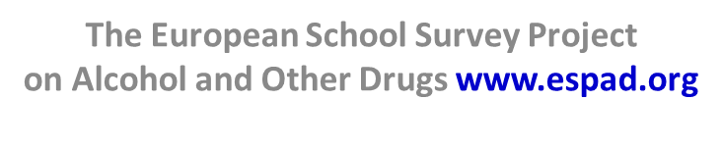



www.hbsc.org
ВЖИВАННЯ ТЮТЮНУ, АЛКОГОЛЬНИХ НАПОЇВ, НАРКОТИЧНИХ РЕЧОВИН УЧНІВСЬКОЮ МОЛОДДЮ
ЗДОРОВ’Я ТА
ПОВЕДІНКОВІ ОРІЄНТАЦІЇ
УЧНІВСЬКОЇ МОЛОДІ
Хвилі опитування в Україні:
2002, 2006, 2010, 2014
Хвилі опитування в Україні:
1995, 1999, 2003, 2007, 2011, 2015
Аналітичні матеріали (національні та міжнародні) доступні на сайті: http://uisr.org.ua/hbsc

Slide 21
Партнери дослідницьких проектів:
Міністерство охорони здоров’я України (міжвідомча робоча група)
Міністерство освіти і науки України
Міністерство молоді та спорту України
Міністерство соціальної політики України
Представництво Дитячого фонду ООН (ЮНІСЕФ) в Україні
Всесвітня організація охорони здоров’я
Регіони опитування: 24 області, АР Крим та м. Київ.
Національна вибіркова сукупність дає можливість аналізу за віком, статтю, типом поселення, регіоном, типом сім’ї, матеріальним станом тощо
... АЛЕ – не передбачає аналізу на рівні області та
навчального закладу)
Метод отримання інформації – самозаповнення
формалізованого запитальника у навчальних аудиторіях
+ індивідуальний конверт

Slide 22


«European School Survey Project on Alcohol and Other Drugs - ESPAD»

Slide 23
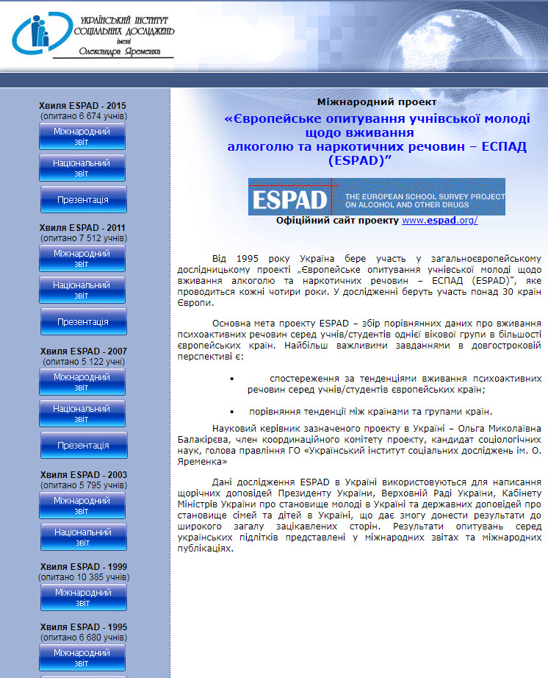

Slide 24
ESPAD in Ukraine
Study waves : 1995, 1999, 2003, 2007, 2011, 2015, 2019 (prep starts)
Partners of the study:
            UN Children’s Fund (UNICEF)
            The European Monitoring Centre for Drugs and Drug Addiction (EMCDDA
            Ministry of Education and Science of Ukraine
            Ministry of Youth and Sports of Ukraine
            State Service on Drug Control
            Co-operation Group to Combat Drug Abuse and Illicit Trafficking in Drugs (Pompidou Group)
Regions of the study:
24 oblasts and Kyiv,
(АR Crimea, except for 2015)
National Sample size enables analysis
by age, gender, type of school,
type of settlement, region,
type of family material status etc.
Ukraine, 2015:
6674 respondents
aged 15-17 years
449 schools

Slide 25
ЦІЛЬОВІ ГРУПИ ДОСЛІДЖЕННЯ - ESPAD
1
2
3
6680 осіб:
3081 хлопців, 3599 дівчат,
15-16 років
10 386 осіб: 4837 хлопців, 5549 дівчат,
13-17 років
5795 осіб: 2656 хлопців,
3139 дівчат),
13-17 років
1995 рік
1999 рік
2003 рік
4
5
6
5122 осіб: 2354 хлопці, 2768 дівчат),
15-16 років
7512 осіб:
4157 дівчат 3355 хлопців,
15-17 років
6674 осіб:
3215 хлопців,
3459 дівчат,
15-17 років
2007 рік
2011 рік
2015 рік
У 2015 році було опитано
449 класних керівників/кураторів груп
Учні 9-11 класів загальноосвітніх шкіл і 1-2 курсів ПТНЗ/ВНЗ І-ІІ р.а.

Slide 26
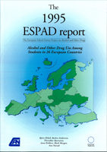
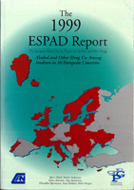
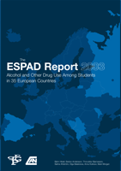
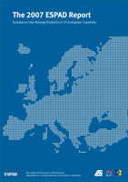

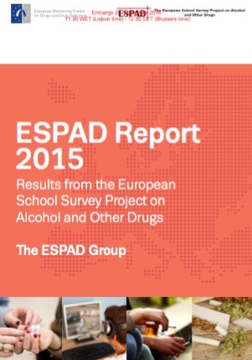

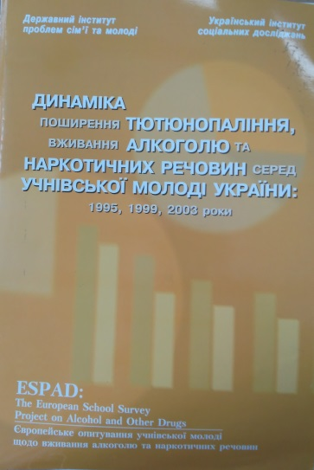
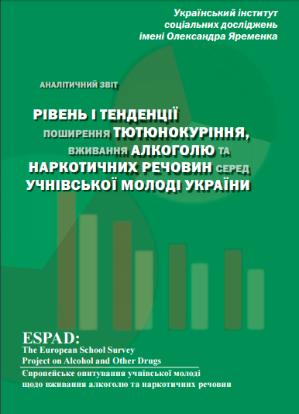
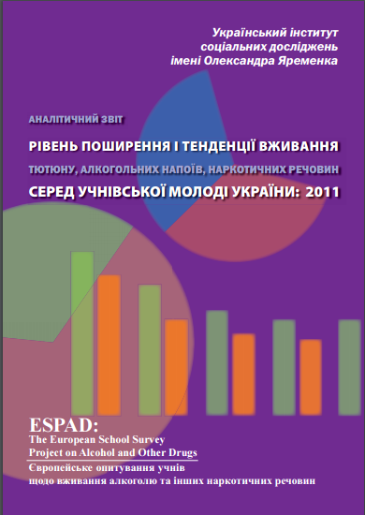

ESPAD Reports
International reports ESPAD: www.espad.org
National reports ESPAD: www.uisr.org.ua/espad

Slide 27

Questionnaire topics
The prevalence of alcohol consumption
The prevalence of tobacco use
The prevalence of drug use
Leisure, family, friends
The dependence of students on the Internet, gaming, gambling
Consumption of new substances that imitate drugs
Country specific questions
Sexual life and behavior
Addressing medical and social services
Adolescents’ mental health
Events on the East of the country
Since 2007, the items on HIV/AIDS knowledge are traditional for Ukraine

Slide 28
Perceived availability of substances
Distribution of answers «very easy» and «fairly easy»), %

Slide 29
Early onset of substance use
(cigarettes and alcohol)
Prevalence of experiencing at the age of 13 or younger, %
Experiencing smoking

Slide 30
Smoking (1)
UKRAINE: a part of young people who smoked at least once during lifetime, % by gender, in dynamics
25 European countries: a part of young people, who smoked at least once during lifetime, % by gender, in dynamics

Slide 31
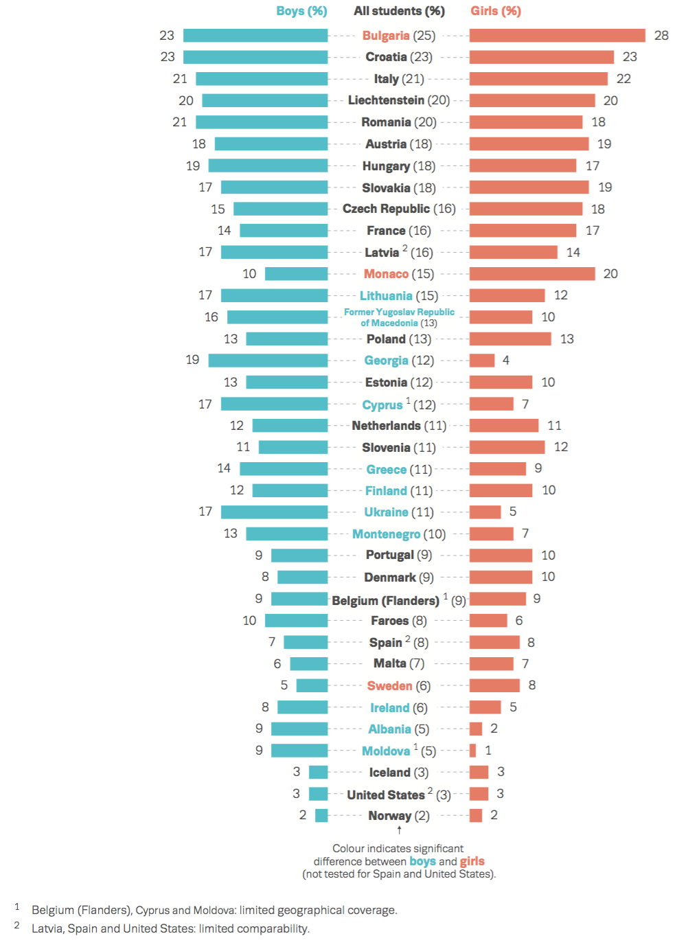
Smoking (2)
Young people, who smoke daily during last 30 days, %
In Ukraine, every eighth 15-17 year old adolescent smokes daily.
Young people of 25 countries who smoked at least once during past 30 days, % by gender, in dynamics

Slide 32
Alcohol consumption (1)
Lifetime alcohol consumption – 84% (82% among boys and 86% among girls).
Dynamics of alcohol consumption at least once for the past 12 months, %

Slide 33
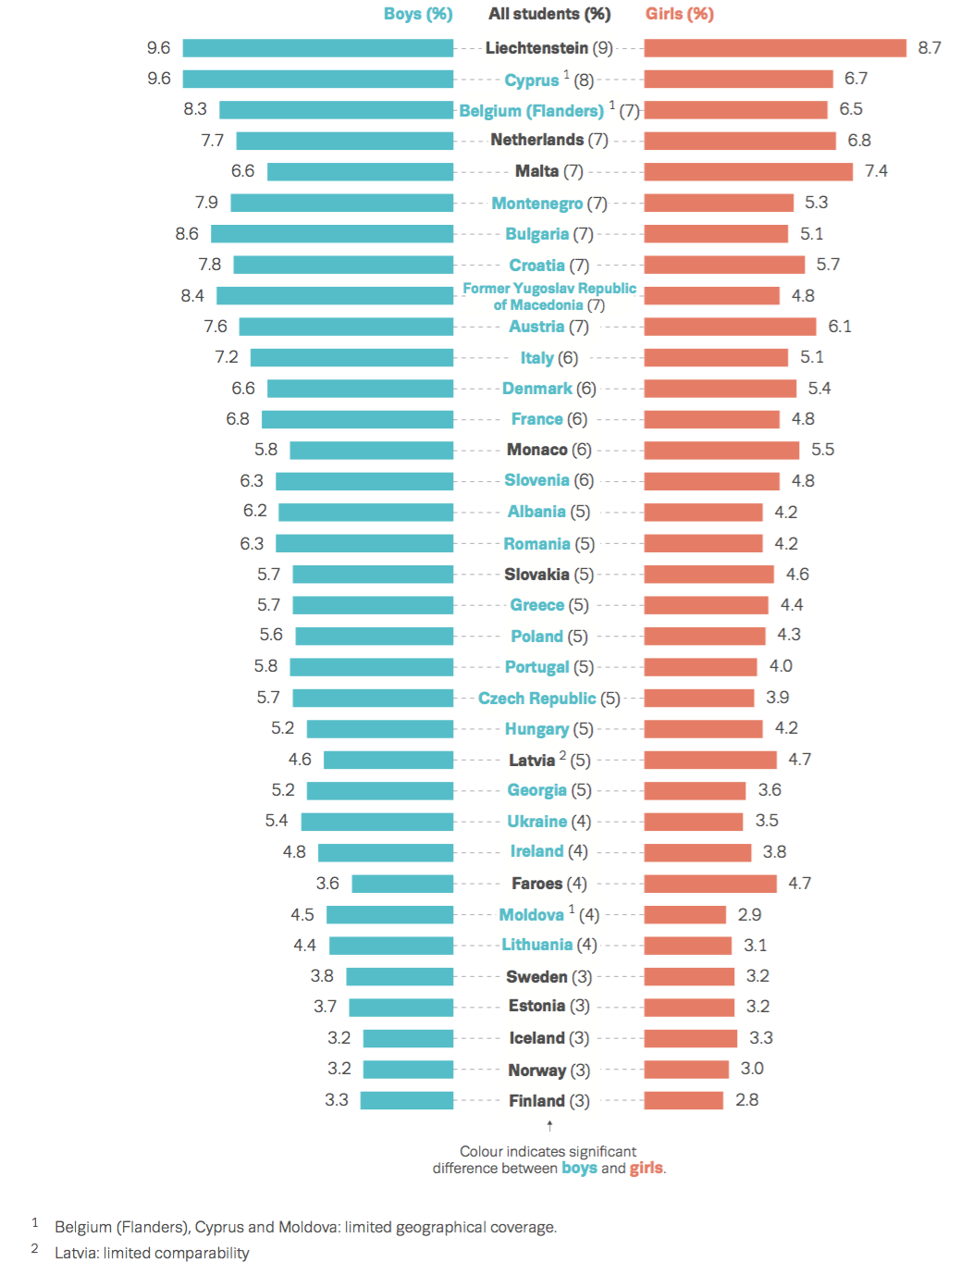
Alcohol consumption(2)
Average frequency of alcohol intake in the last 30 days by gender (mean number of occasions among users).
(”Порція” –
Every sixth adolescent consumes alcohol on weekly basis or more often.
During past 30 days:
41% girls and 32% boys consumed vine;
34% of young people 15-17 years of age had beer (48% among boys and 26,5% among girls);
30% have consumed alcopops;
every fifth adolescent consumed spirits.

Slide 34
Availability trends of marijuana or hashish in dynamics, % by gender (sum of answers «very easy» and «fairly easy»)
Drug use (1)
Perceived availability of marijuana or hashish in selected European countries, % (sum of answers “ very easy” and “ fairly easy”)

Slide 35
Drug use (2)
Dynamics of use of any drugs during lifetime, % by gender

Slide 36
The experience of new substance use consumption, % by age and gender
New substances that imitate the effects of illicit drugs (such as cannabis or ecstasy) may now be sometimes available. They are some times called (‘legal highs’, ‘ethno botanicals’, ‘research chemicals’ and can come in different forms, for example – herbal mixtures, powders, crystals or tables.
Among those who had used such substances during the last 12 months, the highest percentage was used in the form of smoking mixtures - 3.7% (4.6% among boys and 2.8% among girls).
5,4% of students do not know or are not sure whether they have consumed these substances.

Slide 37
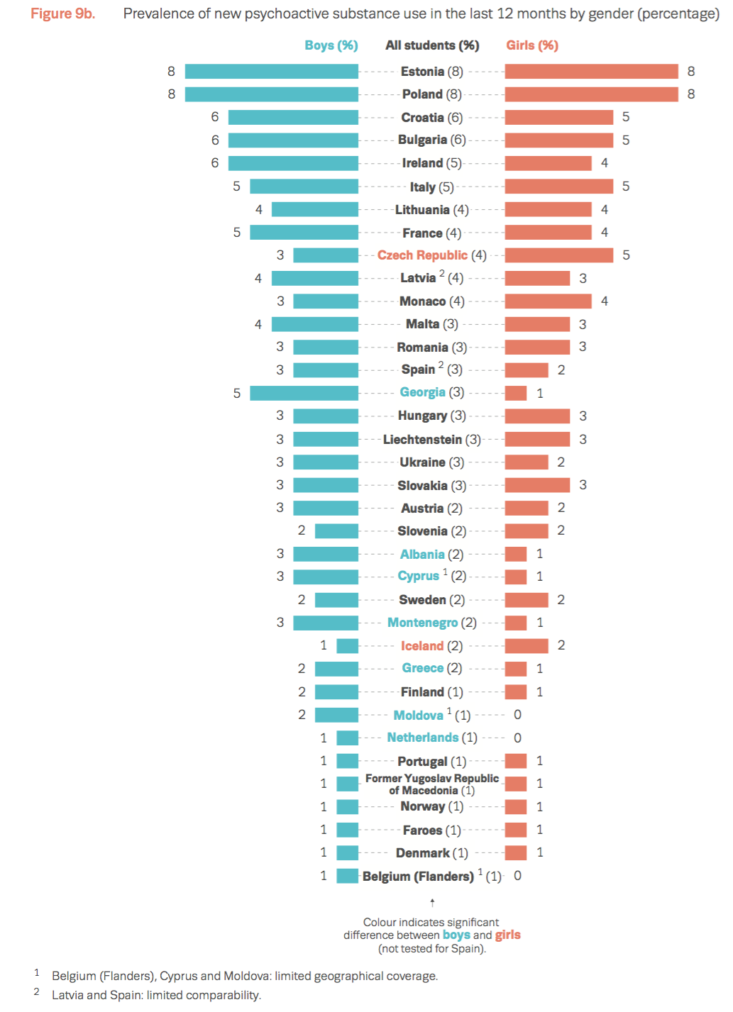
New substances use
Prevalence of new psychoactive substance use in the last 12 months by gender, %.
In Ukraine:
Every tenth respondent smoked water pipe during past 30 days

Slide 38
Internet use(1)
The level of use of the Internet on weekdays and weekend during last week,% by gender
Students that have used Internet for 6 and more hours during one day in the past months, by selected activities, % by gender

Slide 39
Internet use (2)
The level of Internet use on working days and weekends during the last week, %
During working day (Monday- Friday)
During weekend (Saturday – Sunday)
52,3%
Every third adolescent spends more than 4 hours in Internet during working day
Every second adolescent spends more than 4 hours during the weekend.

Slide 40
Compulsive Internet Use*
The compulsive Internet use index among the respondents ,% by gender
 | Boys | Girls | Among all
No Internet dependency | 10,9 | 6,1 | 8,4
Moderate Internet dependency | 79,3 | 82,5 | 81,0
Strong Internet dependency | 9,8 | 11,4 | 10,6
*Integral indicator, which is measured by 14 items - the The Compulsive Internet Use Scale (CIUS)

Slide 41
Gambling (1)
The part of adolescents, who gambled at least 1 time during the last 12 months,
% by age and gender

Slide 42
Gambling (2)
Types of games,% of respondents, who played ON THE INTERNET with some frequency during last 12 months
Types of games,% of respondents, who played NOT ON THE INTERNET with some frequency during last 12 months

Slide 43
Dependency on online games*
Problematic online-gaming, %
 | Boys | Girls | Among all
No dependency on online gaming | 27,4 | 69,0 | 49,3
Moderate dependency on online gaming | 66,4 | 30,1 | 47,3
Strong dependency on online gaming | 6,2 | 1,0 | 3,4
*Integral indicator, which is measured by 12 items concerning the online games - Problematic Online Gaming Questionnaire POGQ−ST.
Notes:
Респондентам було поставлено запитання стосовно того, чи відчували вони коли-небудь потребу ставити все більше і більше грошей в азартній грі та чи доводилося їм брехати близьким про кількість витрачених на гру коштів.
Відсутність проблем через азартні ігри – відсоток тих, хто дав відповідь «Ні» на обидва запитання; залежність від азартних ігор – відсоток тих, хто хоча б на одне запитання дав відповідь «Так»; проблематична залежність від азартних ігор – відсоток тих, хто дав відповідь «Так» на обидва запитання. В сумі відсотки не становлять 100, оскільки ті, хто відповів «Так» на обидва запитання є частиною тих, хто відповів «Так» хоча б на одне запитання.

Slide 44
Other results are presented in the national and international reports:
The prevalence of adolescents’ consumption of certain alcoholic beverages: beer, wine, champagne, soft drinks, spirits
The volume of alcohol consumption by adolescents
Places of consumption
The consumption of different types of psychoactive substances
The consumption of energy drinks, including with alcohol
Poly drug use (the combined consumption of psychoactive substances)
The characteristics of the substance use risks
Parent family
Relations with parents
Sexual relations (in the context of HIV – infection)
The application for social services and medical assistance

Slide 45
Recommendations
(evidence based strong implication for policy)

Slide 46
Recomendations (1)
Implementation of a comprehensive alcohol and drug policy, aimed at reducing the prevalence of substance use among the general population and among young people, in particular, among school-aged children.
On-going monitoring and evaluation of implementation of already adopted legislation, orders, regulations prohibiting smoking and drinking alcohol in public places.
Expansion the interaction network of Youth Friendly Clinics, non-governmental organizations experts with school staff.
Implementation of preventive programs for adolescents who use non-injective drugs, promotion of methods and best practices of interventions.

Slide 47
Recomendations (2)
Formation and implementation of measures to conduct antinicotine informational and educational campaign for students, parents and professionals.
Taking into account successful implementation of the educational course “Health Basics”, continue systematic educational work with children and adolescents in the area of health promotion. Prevention programs should be aimed at the high school students, student of vocational schools and higher educational institutions.
The implementation of social programs for MARA and their immediate environment, work with families in difficult life circumstances.
Strengthening preventive education on the use of Internet resources.

Slide 48
Recomendations (3)
General educational establishments need to develop a strategy for cooperation with parents, to actively involve them in the school life, offer common forms of entertainment on campus, to inform about the results of the school surveys with a focus on the adolescents’ assessment of the parents’ awareness level.
The active involvement of youth in public control over the regulations observance and implementation of programs designed to support health promotion, including a ban on the sale of alcohol to minors, their use in public places, etc.

Slide 49



Здоров’я та поведінкові орієнтації учнівської молоді
Health Behavior in School-aged Children:
a cross-national study - 2014

Slide 50
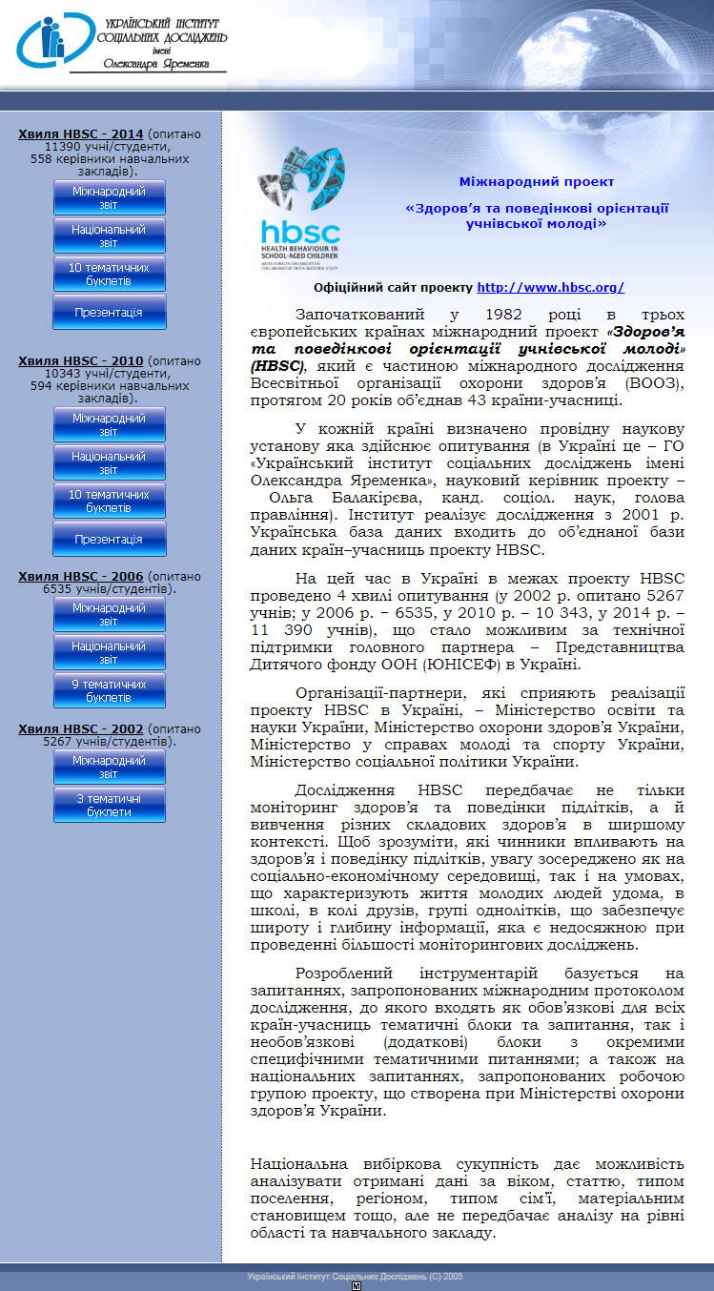
ВІДКРИТО ДОСТУП ДО ДАНИХ HBSC
ПРО ЗДОРОВ’Я ПІДЛІТКІВ У 41 КРАЇНІ
Відкрито доступ до даних
2002, 2006, 2010.
Очікується відкриття доступу до даних 2014.
Відкритий доступ до даних за посиланням: www.hbscdata.uib.no
Дані представляють великий потенціал для:
підготовки наукових праць, статей, дисертаційних і докторських робіт;
тих, хто готує і приймає в Україні рішення з питань збереження здоров’я, формування здорового способу життя та виховання здорової поведінки української молоді, що навчається (керівникам органів державної влади та управління, впливовим політикам, громадським діячам, вчителям, медпрацівникам тощо).

Slide 51






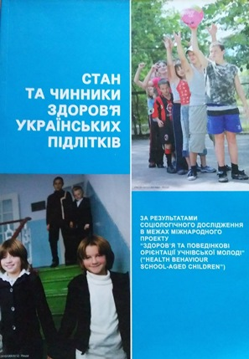
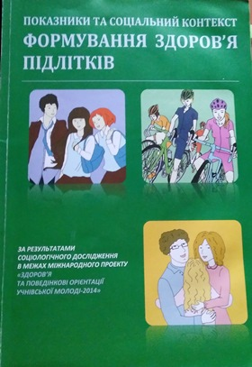
Публікації HBSC
Міжнародні звіти HBSC: www.hbsc.org
Національні звіти HBSC: www.uisr.org.ua/hbsc

Slide 52
ЦІЛЬОВІ ГРУПИ ДОСЛІДЖЕННЯ - HBSC
11-12 років
13-14 років
15-16 років
17 років
5-6 клас
ЗОНЗ
7-8 клас ЗОНЗ
9-10 клас ЗОНЗ;
1 курс ПТНЗ (після 9 кл.);
1 курс ВНЗ І-ІІ рів. акр. (після 9 кл.)
11 клас ЗОНЗ;
2 курс (після 9 кл.) ПТНЗ
2 курс (після 9 кл.) ВНЗ І-ІІ рів. акр.
11930 респонденти
747 класів/груп

Slide 53
МЕТОДОЛОГІЯ МІЖНАРОДНИХ
НАУКОВИХ ДОСЛІДЖЕНЬ ESPAD and HBSC
Базуються на міжнародному протоколі наукового дослідження, який:
Використовують всі країни-учасниці проекту
Надає концептуальну основу
Має узгоджений набір певних показників

Slide 54
Інструментарій дослідження базується на:
Запитаннях, запропонованих міжнародним протоколом дослідження, який включає в себе:
Обов'язкові для всіх країн-учасниць тематичні блоки та запитання
Необов'язкові (додаткові) блоки з специфічними тематичними питаннями
Національних запитаннях, актуальних для країни, що пропонуються робочою групою проекту
Здійснюється переклад англійська-українська-англійська

Slide 55
ПЕРЕВАГИ СИСТЕМНИХ ШКІЛЬНИХ ОПИТУВАНЬ
Кожна країна може включити свій блок запитань
та понад-квоти для досягнення та подальшого аналізу окремих груп
Використання результатів для розробки та/або коригування
політики та програм з питань ФЗСЖМ
Доступність шкільної молоді для дослідників
дозволяє зменшити вартість дослідження
Стандартні процедури (вибірка та метод опитування) дають
можливість порівняння у динаміці та між територіями
Стандартний інструментарій та методика забезпечують
порівняння з іншими країнами

Slide 56

Стандартизація
Цільові вікові групи
Національно репрезентативна вибірка (випадковий відбір навчальних класів/груп)
Стандартизований опитувальник
Уніфікований дослідницький протокол
Стандартизовані регіональні плани досліджень
Стандартизована процедура збору даних
Етика, анонімність та конфіденційність
Терміни збору даних
Стандартизована звітність щодо проведення збору даних
www.espad.org

Slide 57
Переваги участі
Економічно
Доступ до анкети та методології
Надійність даних та відслідковування тенденцій
Можливість порівняння з іншими європейськими країнами
Визначення чинників різних моделей поведінки
Ґрунтовна база для корегування/вдосконалення профілактичної діяльності та політики
Складова оцінки національної стратегії
Обмін досвідом між командами країн (в т.ч. – шляхи досягнення навчальних закладів)
www.espad.org

Slide 58
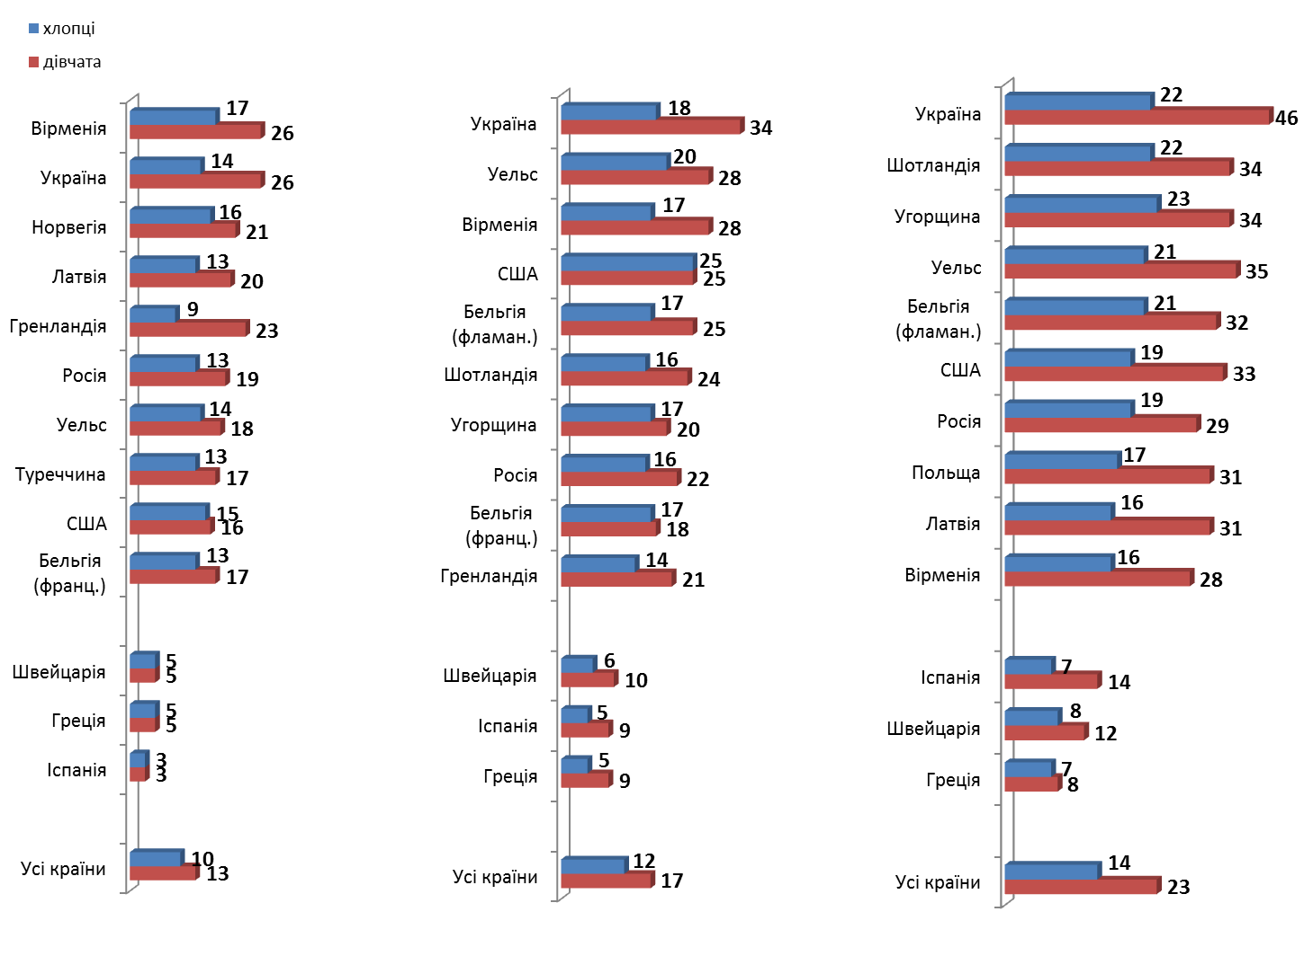
Самооцінка учнями свого здоров’я (у порівнянні з європейськими країнами-учасницями проекту HBSC-2010)
сума відповідей «Посереднє» та «Погане»
11 - річні
13 - річні
15 - річні

Slide 59
Проблема: узгодженість шкал
Різні системи навчання в країнах-учасницях
3.(МQ3) | В якому місяці ти народився(лась)?
 | 1  | Січень | 4  | Квітень | 7  | Липень | 10  | Жовтень
 | 2  | Лютий | 5  | Травень | 8  | Серпень | 11  | Листопад
 | 3  | Березень | 6  | Червень | 9  | Вересень | 12  | Грудень
4.(МQ4) | В якому році ти народився(лась)?
 | 1  | 2  | 3  | 4  | 5  | 6  | 7  | 8  | 9  | 10 
 | 1995 | 1996 | 1997 | 1998 | 1999 | 2000 | 2001 | 2002 | 2003 | 2004
MQ2 | What class are you in?
₁ ▢ | Country specific Grade (11 year old)
₂ ▢ | Country specific Grade (13 year old)
₃ ▢ | Country specific Grade (15 year old)

Slide 60
Проблема: узгодженість шкал
Різне розуміння структури сім’ї (напр., не кожна дитина проживає разом з обома батьками, іноді діти живуть лише з одним із батьків, або у них може бути дві домівки, або дві сім’ї)
Будь ласка, зазнач про твій дім, в якому ти перебуваєш весь час або більшу частину часу, і відміть тих людей, які живуть разом із тобою. |  |  | Будь ласка, зазнач, якщо ти маєш інший дім або іншу сім’ю, наприклад, у разі, якщо твої батьки розійшлися (розлучилися).
Будь ласка, познач усіх, із ким ти живеш удома |  |  | Будь ласка, познач усіх, з ким ти живеш тут
Дорослі: |  |  | Дорослі:
1 | Мама |  | 1 | Мама
2 | Батько |  | 2 | Батько
3 | Мачуха (або подруга батька) |  | 3 | Мачуха (або подруга батька)
4 | Вітчим (або друг матері) |  | 4 | Вітчим (або друг матері)
5 | Бабуся |  | 5 | Бабуся
6 | Дідусь |  | 6 | Дідусь
7 | Я живу в прийомній сім'ї або дитячому будинку сімейного типу У гуртожитку Живу окремо від батьківської сім’ї, у власній квартирі/будинку або в орендованій(ому) квартирі/будинку |  | 7 | Я живу в прийомній сім'ї або дитячому будинку сімейного типу
8 | З кимось або десь ще: будь ласка, впиши………………………...……… |  | 8 | З кимось або десь ще: будь ласка, впиши………………………...………

Slide 61
Проблема: статева ідентичність
a) How feminine do you feel? (question for girls and boys)
Very feminine | O | O | O | O | O | Not at all feminine
b) How masculine do you feel? (question for girls and boys)
Very masculine | O | O | O | O | O | Not at all masculine
Others say, you behave (Другие говорят, что Вы ведете себя …)
O always like a girl
O most of the time like a girl
O most of the time like a boy
O always like a boy.

Slide 62




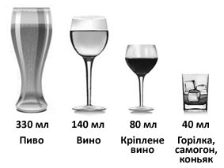



Проблема: різні міри вимірювання
ESPAD. Скільки днів (якщо таке траплялося) ти вживав(ла) алкогольний напій? Протягом останніх 7 днів я випивав(ла) алкогольні напої ___дні(в). (0 = взагалі не пив(ла), 7 = щодня)
a. Скільки пляшок (бляшанок) або бокалів пива ти випив(ла)? |  |  | 1 маленька пляшка або 1 маленький бокал пива = 330 мл
b. Скільки келихів вина або шампанського ти випив(ла)? |  |  | 1 маленький келих вина або шампанського = 100 мл
c. Скільки чарок/склянок міцних напоїв ти випив(ла)? |  |  | 1 чарка міцного напою = 40 мл
d. Скільки склянок алкогольних коктейлів ти випив(ла)? |  |  | 1 склянка алкогольного коктейлю = 330 мл
HBSC 42.(МQ24) |  | Скільки порцій алкоголю ти зазвичай випиваєш у день, коли вживаєш алкоголь? Використовуй ПРИКЛАДИ стандартних порцій, що показані на рисунку
 | 1  | Я ніколи не вживаю алкоголь
 | 2  | Менше 1 порції
 | 3  | 1 порцію
 | 4  | 2 порції
 | 5  | 3 порції
 | 6  | 4 порції
 | 7  | 5 і більше порцій

Slide 63
Важливість пілотування
When (if ever) did you FIRST do each of the following things?
a) Try tranquillisers or sedatives (without a doctor’s prescription)
b) Try amphetamines
c) Try ecstasy
d) Try inhalants [INSERT NATIONALLY RELEVANT EXAMPLES] in order to get high
e) Try alcohol together with pills (medica-ments) in order to get high
Є можливість додати національну особливість!!!!

Slide 64
Ключові акценти
  Проведення постійних національних, репрезентативних опитувань серед молоді дають можливість :
    відслідковувати тенденції
    фіксувати вплив змін у політиці, інформаційно-освітніх програмах, регулюванні рекламної діяльності тощо;
    впливати на формування адекватної державної політики щодо проблем молодого покоління;
    визначати актуальні акценти політики з врахуванням особливостей статевовікових груп.
  Постає необхідність розширення вибірки та отримання результатів на рівні окремих областей, оскільки Національна вибіркова сукупність дає можливість аналізу за віком, статтю, типом поселення, регіоном, типом сім’ї, матеріальним станом тощо, ... АЛЕ – не передбачає аналізу на рівні області та навчального закладу
Notes:
Науковий супровід діяльності щодо формування здорового способу життя передбачає моніторинговий характер, оскільки важливим є системне та регулярне вимірювання на різних етапах.
Завдяки цьому можна визначити динаміку (тенденцію) кількісних та якісних змін, прогнозувати розвиток ситуації, вчасно коригувати напрями та змістовні компоненти профілактичної діяльності.

Slide 65
Виклики
Державна підтримка наявних досліджень
Запровадження системного моніторингу серед загального населення та молоді
Доступність даних для зацікавлених сторін
Постійна адвокація та регулярне інформування, поширення результатів
Проведення досліджень на рівні окремих регіонів

Slide 66
Виклики: використання даних
Наявні дані соціальних досліджень не усвідомлені як ресурс стратегічної інформації
Відсутній запит на використання наявної інформації
Доцільна розробка національних та регіональних показників, індексів, в тому числі серед підлітків та молоді
Необхідно започаткувати Банк даних соціальних досліджень
Розробка систем підтримки прийняття управлінських рішень – Decision Support Systems (DSS)
Широкомасштабне навчання потенційних користувачів та споживачів інформації; використання та розробка модулів и пакетів аналізу інформації

Slide 67
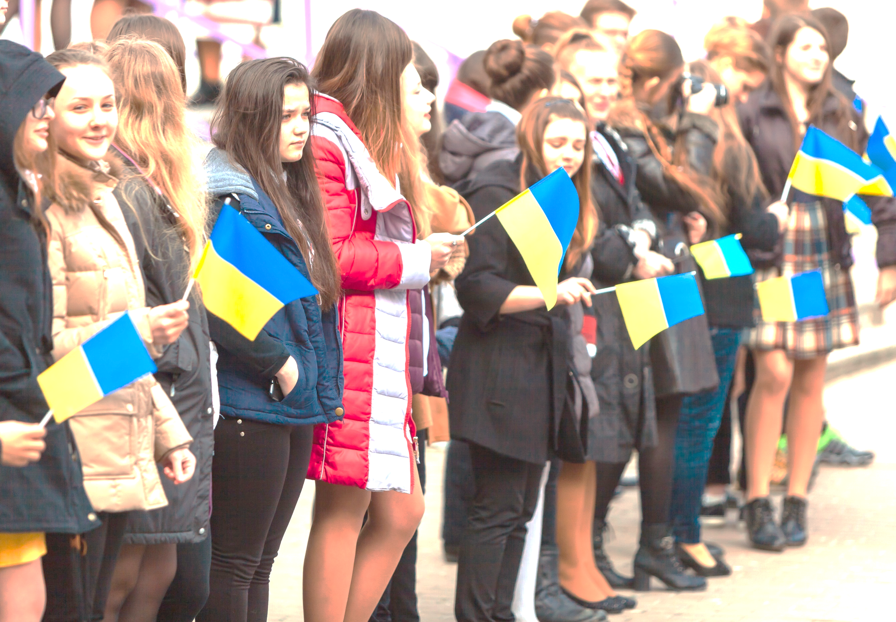

U-Report Ukraine
ТВОЯ ДУМКА ВАЖЛИВА
Інструмент діалогу «молодь – влада»
Швидкі смс-опитування.

Slide 68


